Slide 1
Commons Town Hall
Tuesday, February 11th, 2025

Slide 3
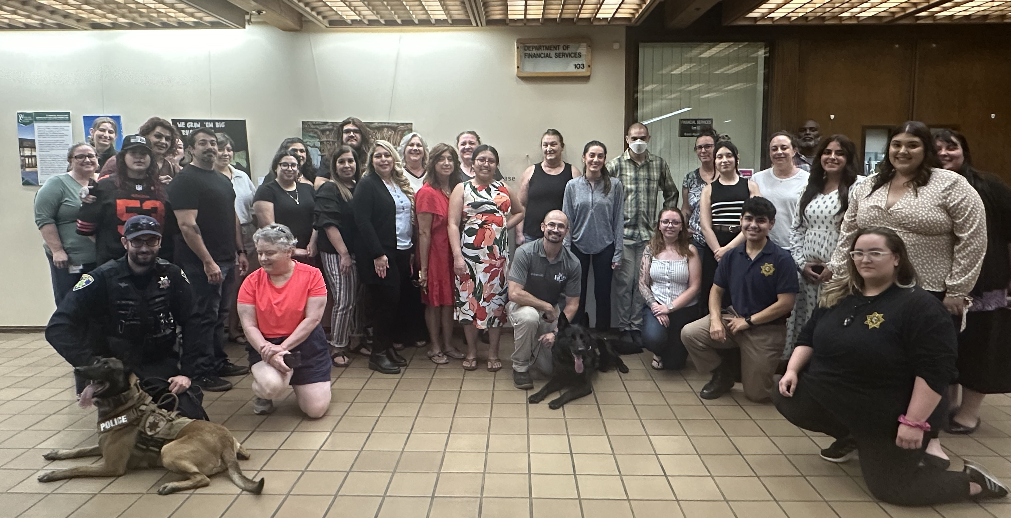
Citizen’s Academy

Slide 4
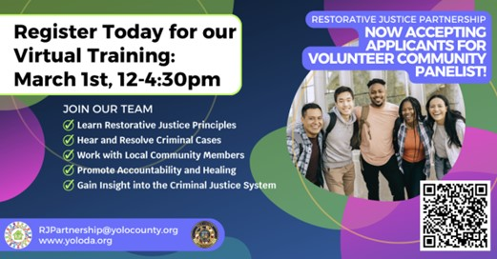
Restorative Justice Partnership

Slide 5
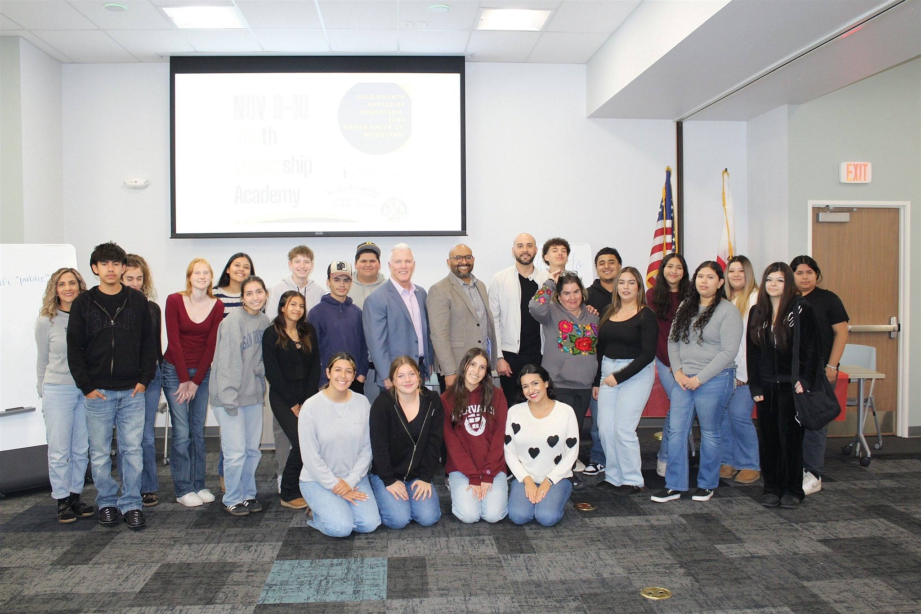
Youth Academy

Slide 6
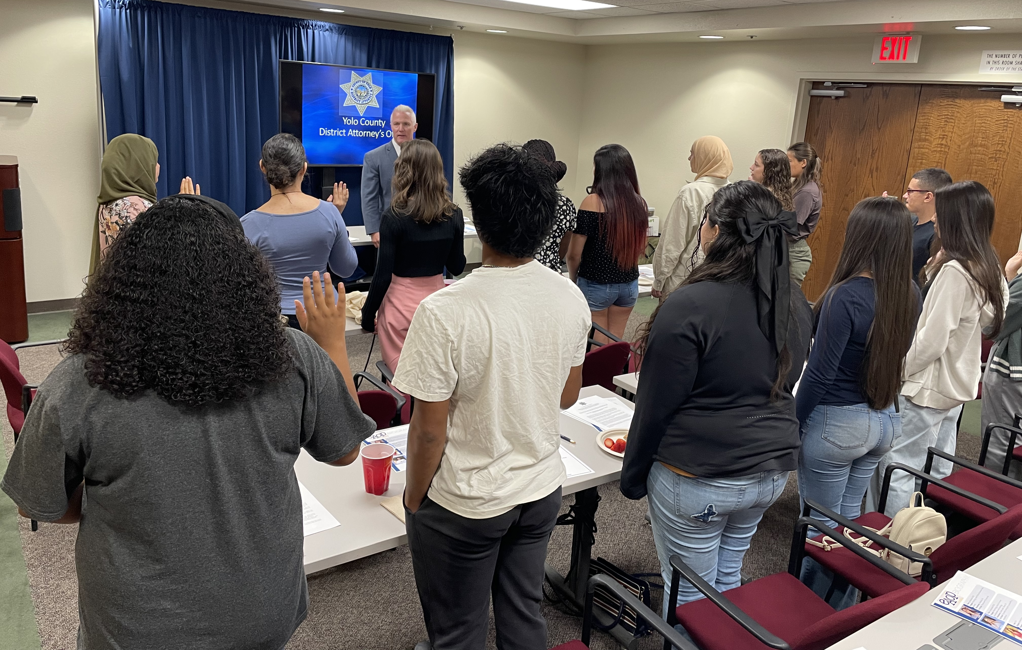
DA for the Day

Slide 7
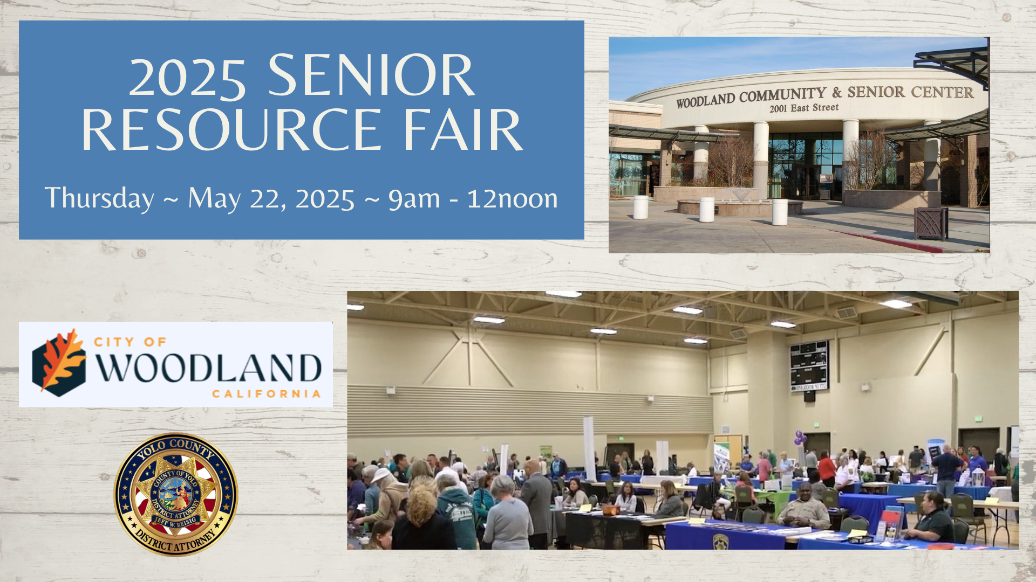
Senior Resource Fair

