Slide 1
Commons Town Hall
Tuesday, December 10th, 2024

Slide 2
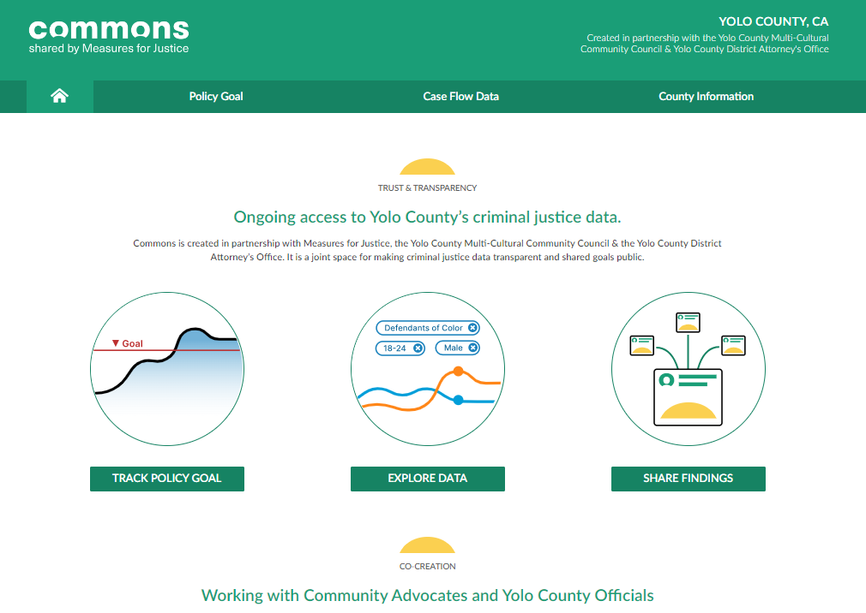
Commons by Measures for Justice

Slide 3
Proposition 36

Slide 4
Larceny Theft Cases Received (2016 – 2023)

Slide 5
Drug Possession Cases Received (2016 – 2023)

Slide 6
Drug Possession Cases Prosecuted (2016 – 2023)

