Slide 1
Commons Town Hall
Tuesday, November 11th, 2024

Slide 2
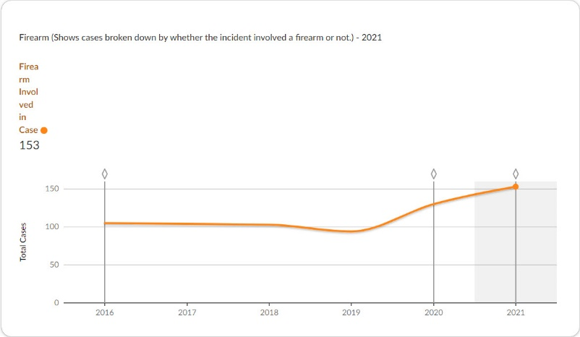
2021 Cases involving Firearms

Slide 3
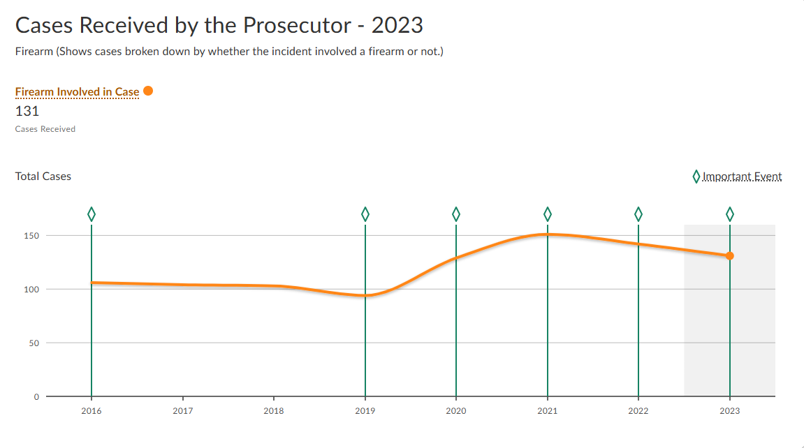
2023 Cases involving Firearms

Slide 4
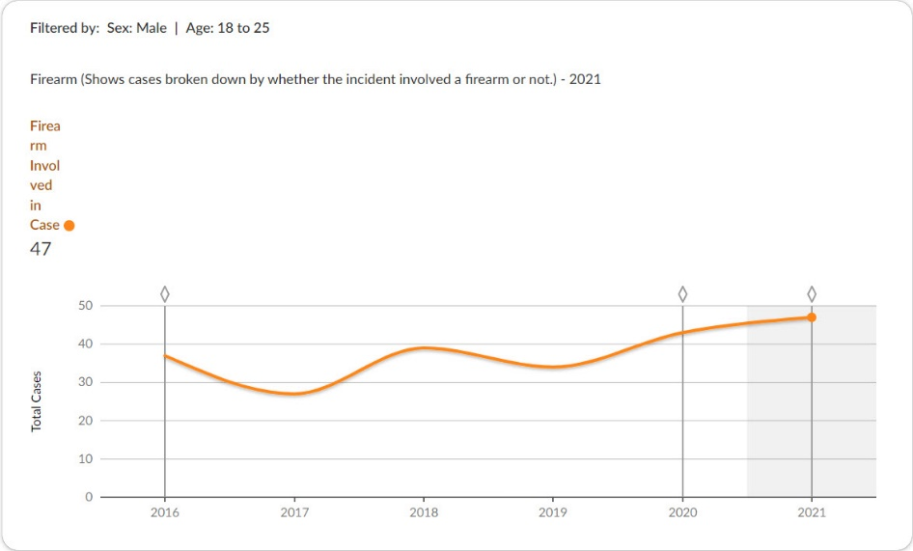
2021 Cases Where Defendant is Male (18-25)

Slide 5
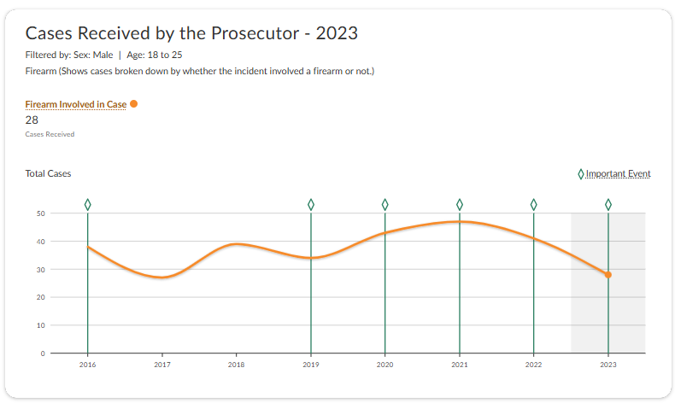
2023 Cases Where Defendant is Male (18-25)

Slide 6
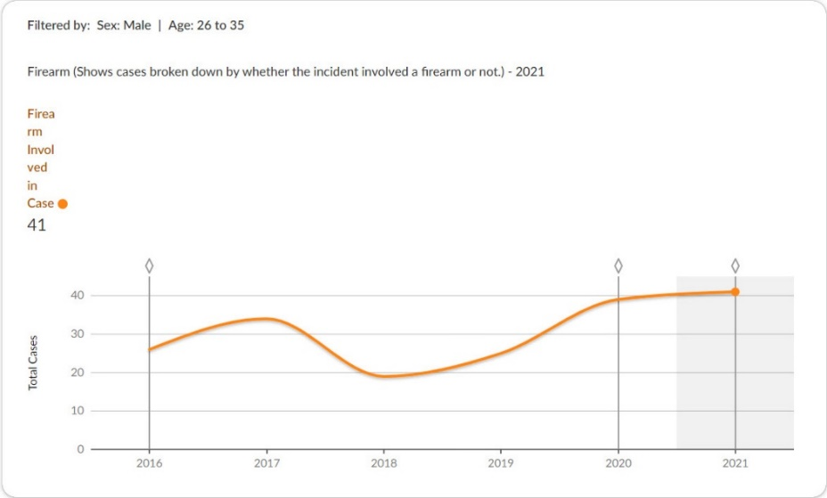
2021 Cases Where Defendant is Male (26-35)

Slide 7
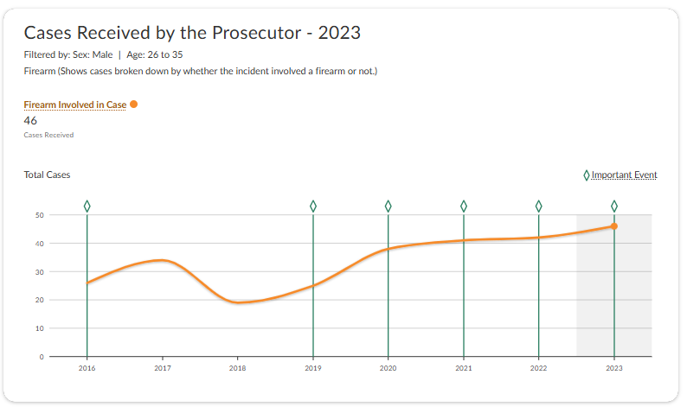
2023 Cases Where Defendant is Male (26-35)

