Slide 1
Commons Town Hall
Tuesday, March 12th, 2024

Slide 2
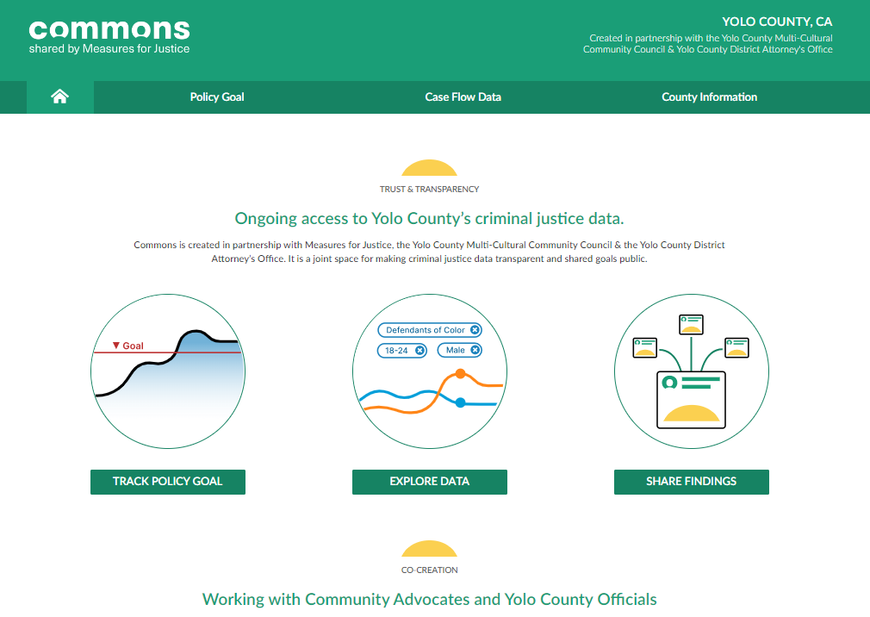
High Tech Crimes Unit

Slide 3
Yolo County High Tech Crimes Unit

Slide 4
Master File Table (MFT) Computer Record

Slide 5
High Tech Team Assisting with WPD Search Warrant

Slide 6
Sex Offender Sweep – Operation Vigilance

Slide 7
Enrique Rios & Elijah Moore

Slide 8
Phone Ping Map

Slide 9
Digital Forensics Laboratory Accreditation

