Slide 1
Commons Town Hall Tuesday, June 13, 2023

Slide 2
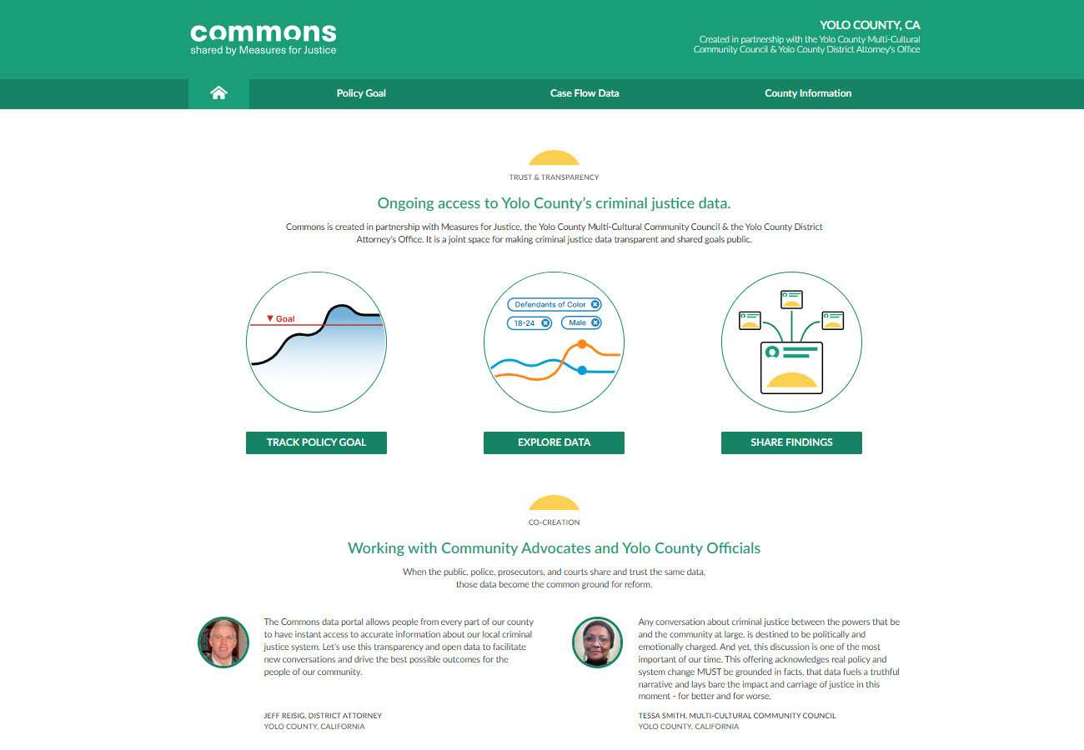
Working with Federal Law Enforcement Partners

Slide 3
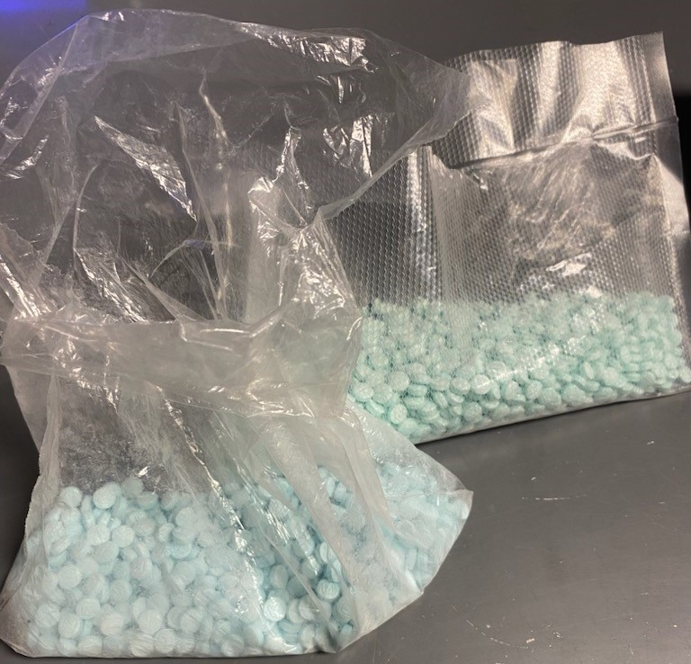
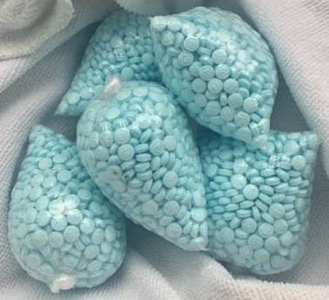
Fentanyl and Drug Trafficking

Slide 4
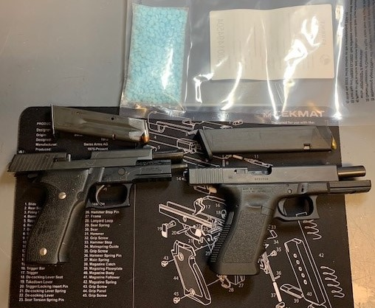
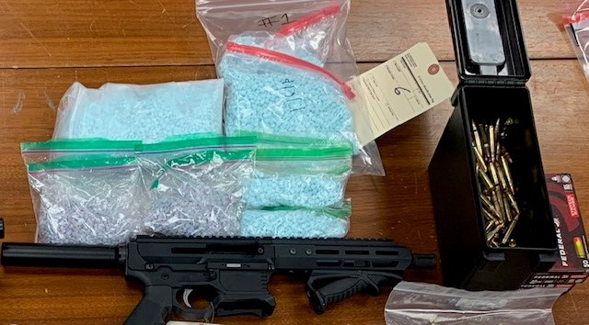
Fentanyl and Drug Trafficking

Slide 5
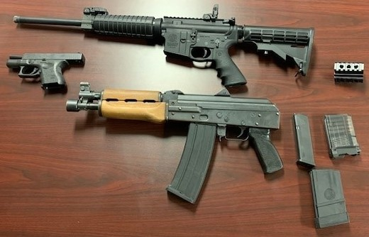
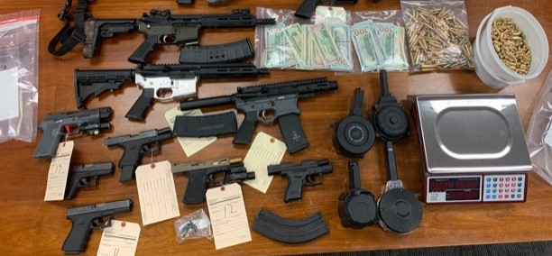
Firearms and Gun Violence

Slide 6
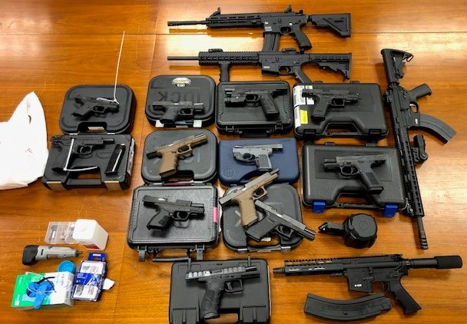
Firearms and Gun Violence

