Slide 1
Commons Town Hall
Tuesday, May 9th, 2023

Slide 2
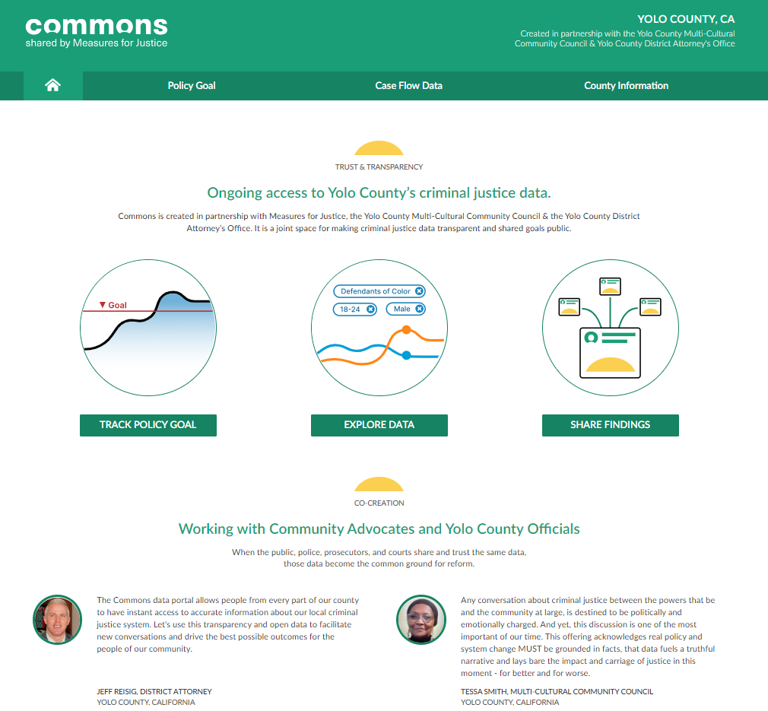
Mental Illness in the Criminal Justice System

Slide 3
Established Programs: Mental Health & Addiction Intervention Court
Felony Conduct
Serious Mental Illness - SMI (schizophrenia, schizo-affective, or bipolar) and/or
Substance use disorder – SUD
Must be YOLO Resident

Slide 4
Mental Health Diversion Court: The Underserved Population
What about how the criminal justice system addresses those who commit crimes and who live with less severe mental illness and/or substance use disorders?
Less severe felonies or misdemeanors conduct?
What if they don’t live in Yolo?

Slide 5
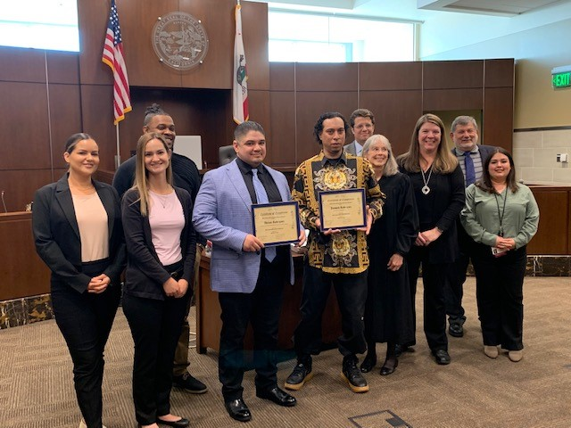
Yolo County Mental Health Diversion Court

Slide 6
Mental Health Diversion Court: The Underserved Population
Community Corrections Partnership (CCP) funding for 1001.36 based program includes:
PD
DA
Probation Officer
Communicare – Case worker, Clinician, Peer Support worker
Not based on Medical funding so Yolo residency and Citizenship not mandatory.

Slide 7
ELIGIBILITY
18 or older
Charged/Convicted of one or more felonies or misdemeanors and in danger of getting charged with first felony.
Participant must agree to MH-DIV and follow the guidelines.
Participant must have the necessary insight and motivation to be successful in the program
MH-DIV Team must all agree on participant’s acceptance

Slide 8
The Program: CommuniCare
Assessment of new referrals
Mental Health Care/Mental Health Referrals
Treatment planning – case by case basis
Peer Support Advocate

Slide 9
The Program: CommuniCare
Intensive case management
Monitoring
Accountability
Coordination

Slide 10
Referrals
Defense counsel identifies and makes the referral
Early is ideal
Participant must agree to MH-DIV and follow the guidelines.
Participant must have the necessary insight and motivation to be successful in the program

Slide 11
What’s in the Secret Sauce?
Collaboration
District Attorney and Public Defender/Defense Counsel
A dedicated judge
Dedicated staff at Probation and Commuincare supervising, providing services and supporting participants

Slide 12
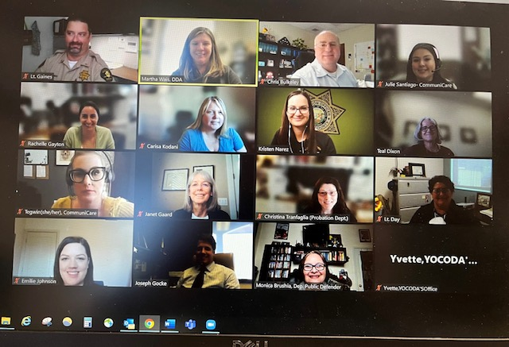
1st MH-Div Meeting JG

Slide 13
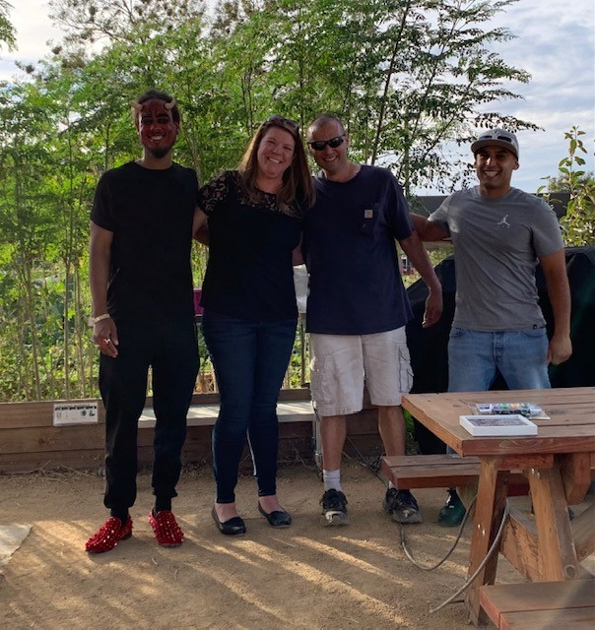
MH-Div Halloween BBQ

Slide 14
1st MH-Div Graduation

Slide 15
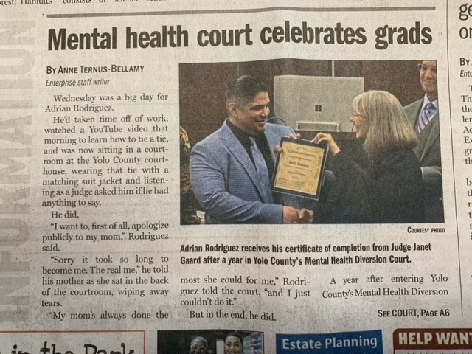
Triumph!

Slide 16
Questions

