Slide 1
Commons Town Hall
Tuesday, April 11th, 2023

Slide 2
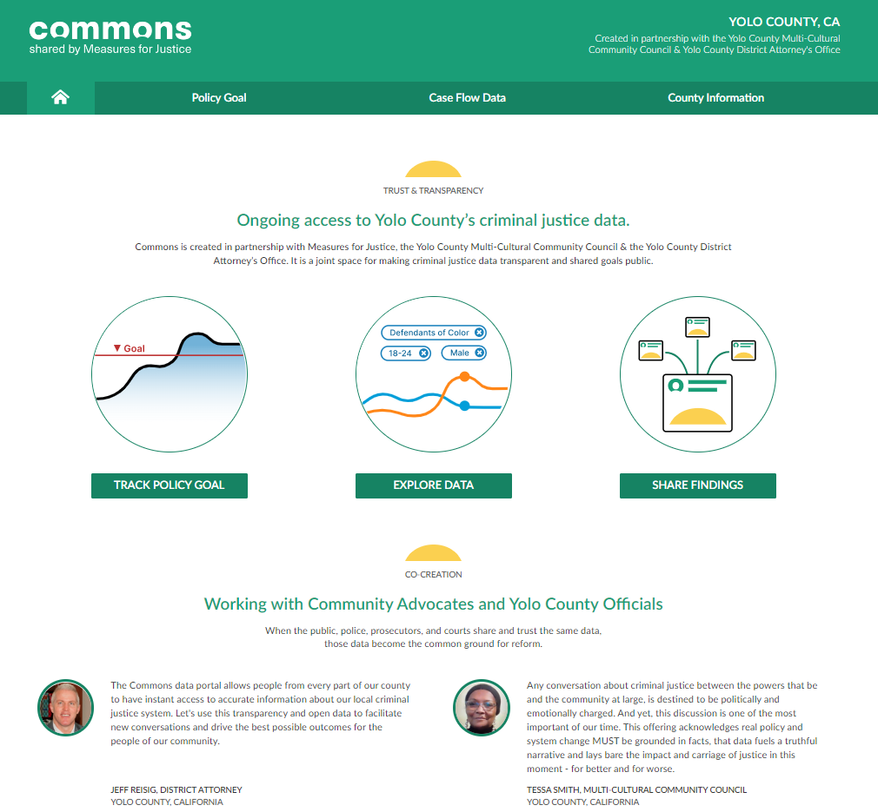
Crimes Involving Child Victims

Slide 3
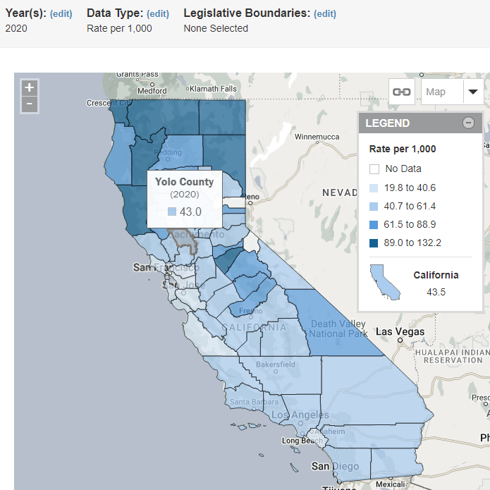
Reports of Child Abuse & Neglect

Slide 4
MDIC Total Referrals & Forensic Interviews

Slide 5
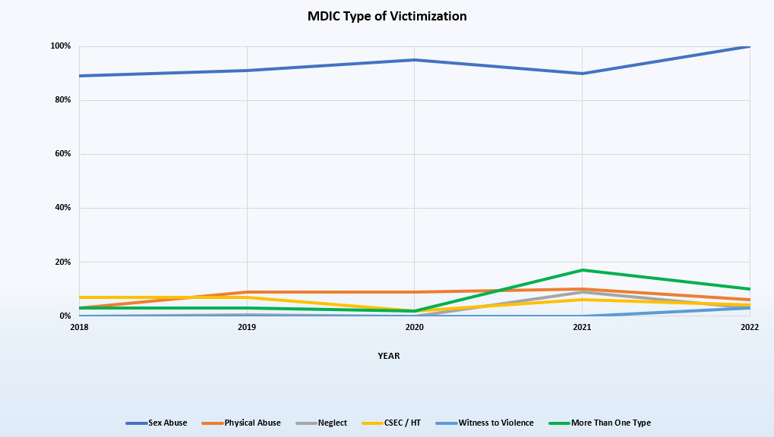
MDIC by Type of Victimization

Slide 6
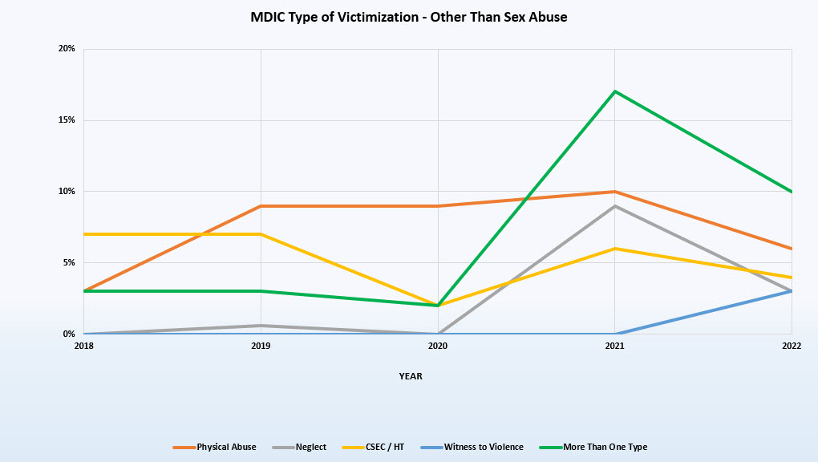
MDIC Victimization – Other Than Sex Abuse

Slide 7
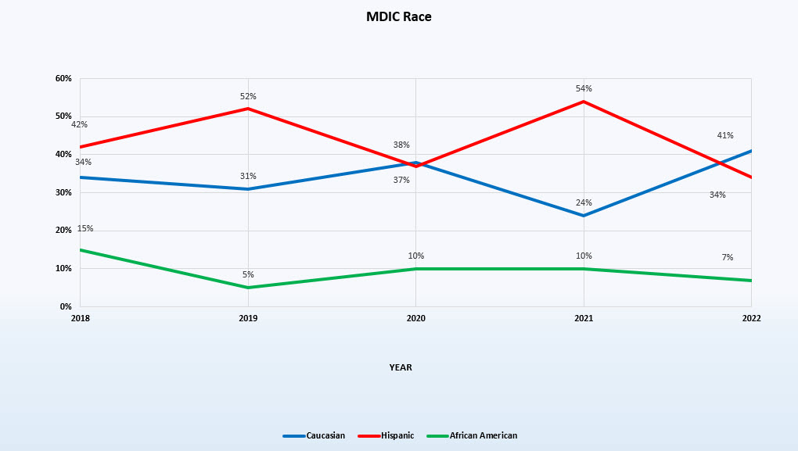
MDIC by Race

Slide 8
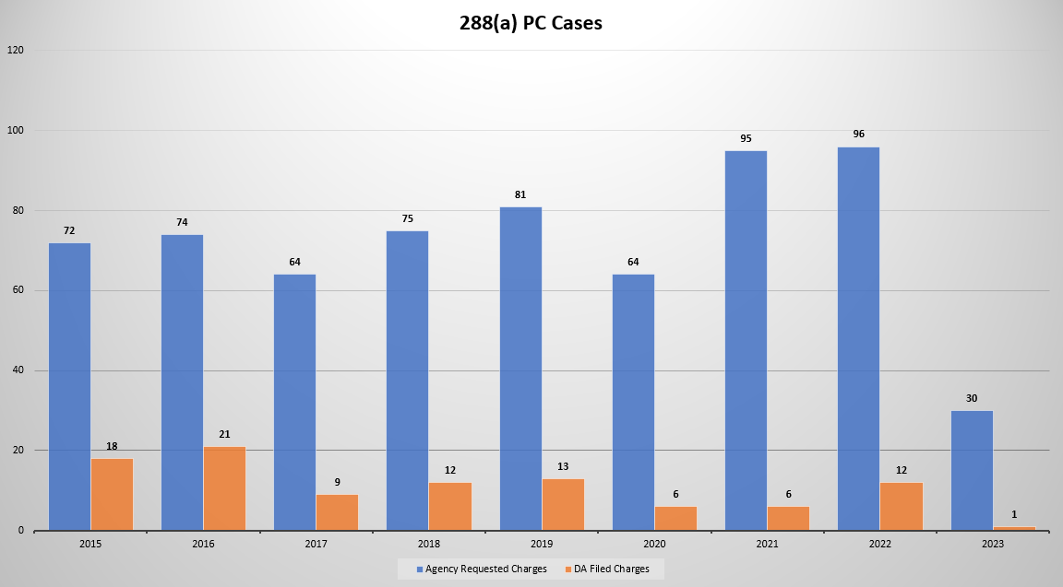
Cases with 288(a) PC Charges

Slide 9
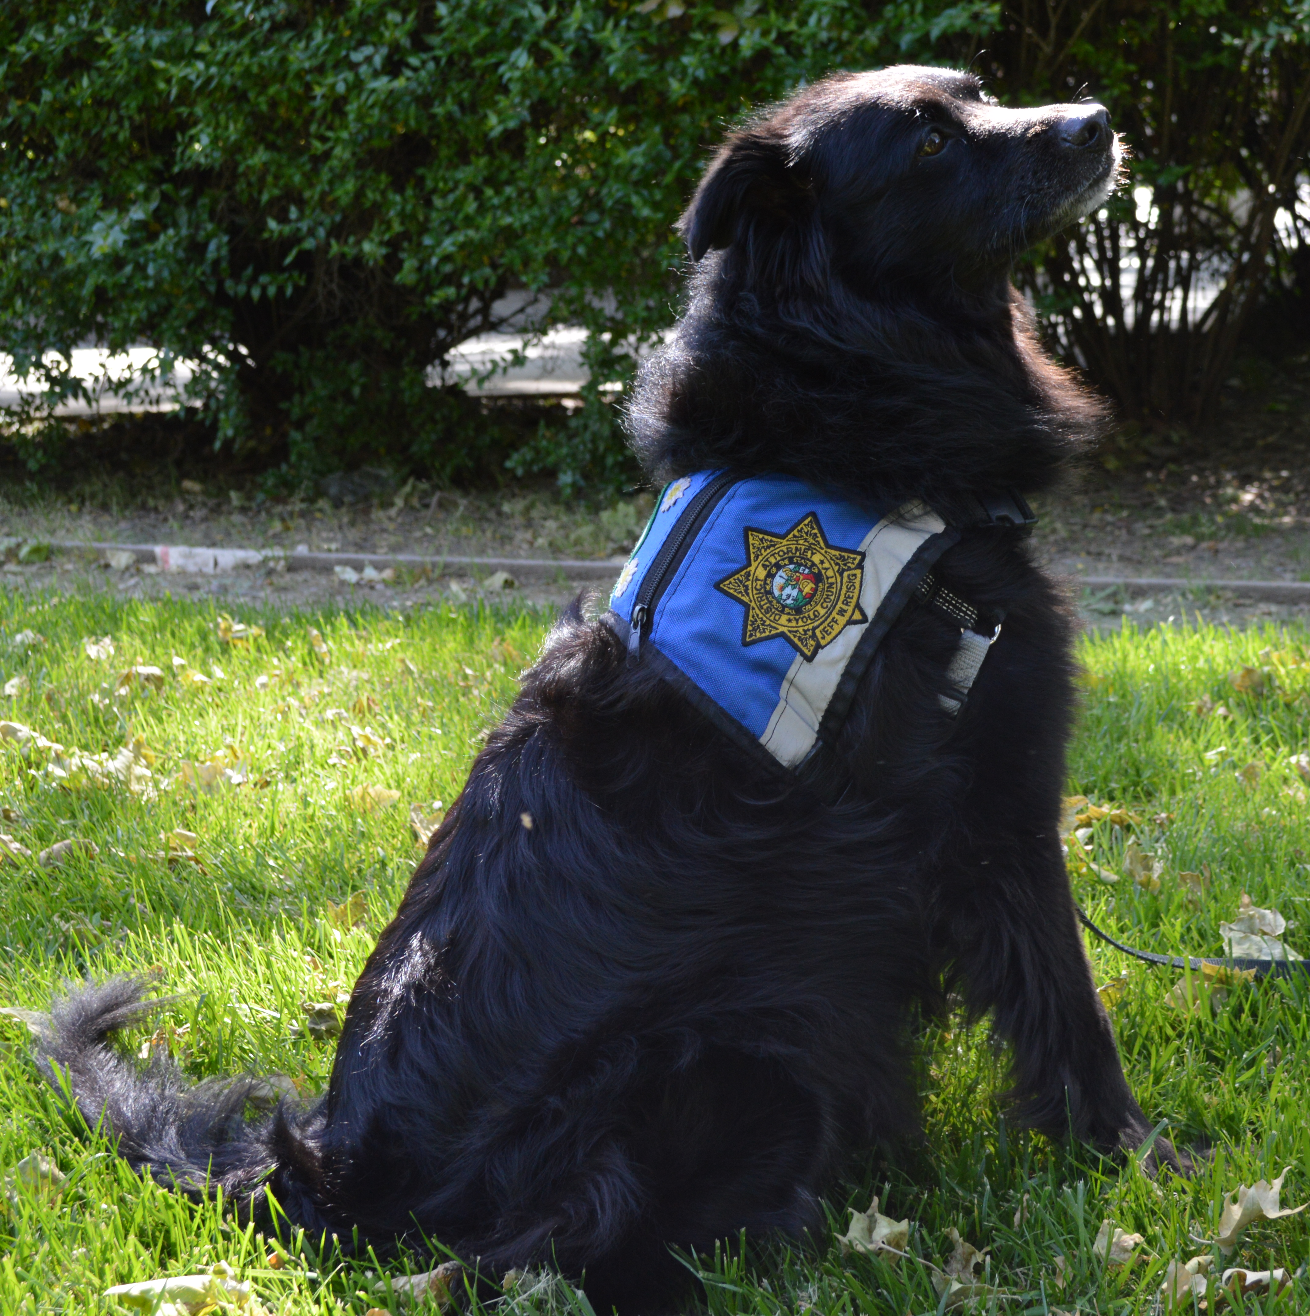
Daisy – Victim Advocate Comfort Dogs

Slide 10
Ace & Aloha – Victim Advocate Comfort Dogs

