Slide 1
Commons Town Hall
Tuesday, March 14th, 2023

Slide 2
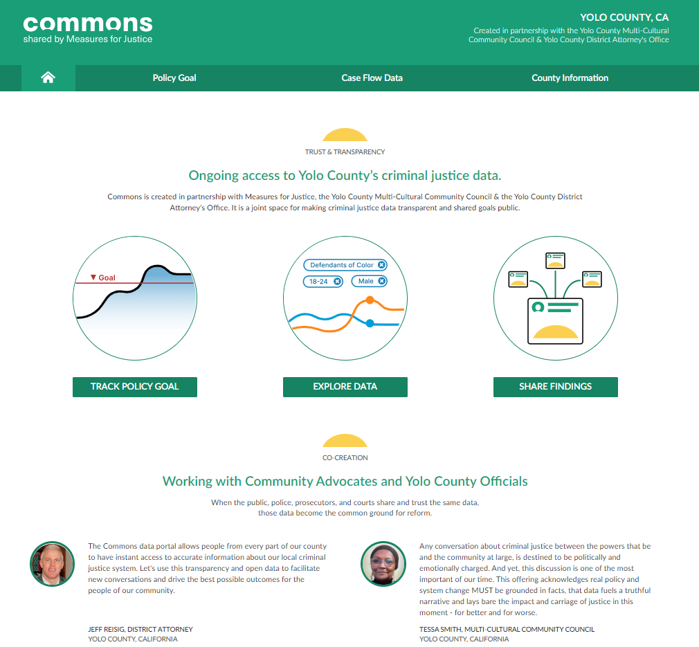
Crimes Described as “Non-Violent” in CA

Slide 3
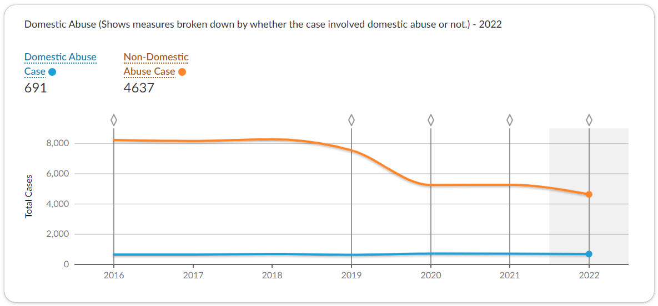
Domestic Abuse Cases Referred

Slide 4
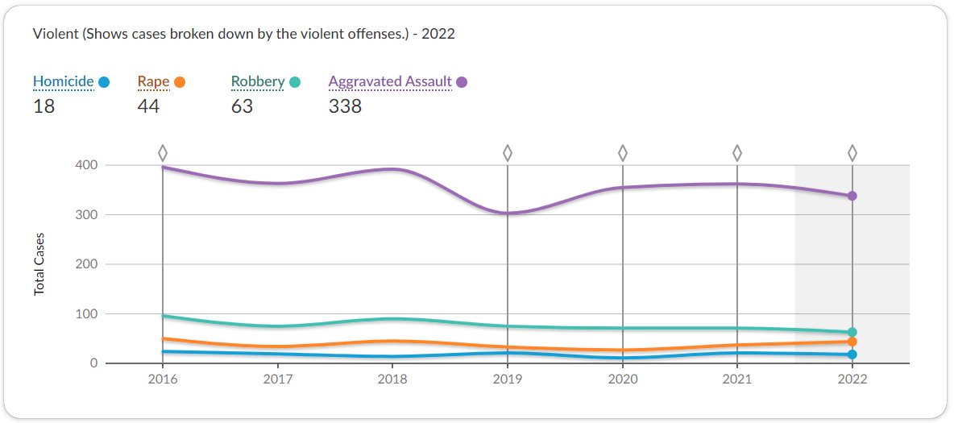
Violent Crime Cases Referred

Slide 5
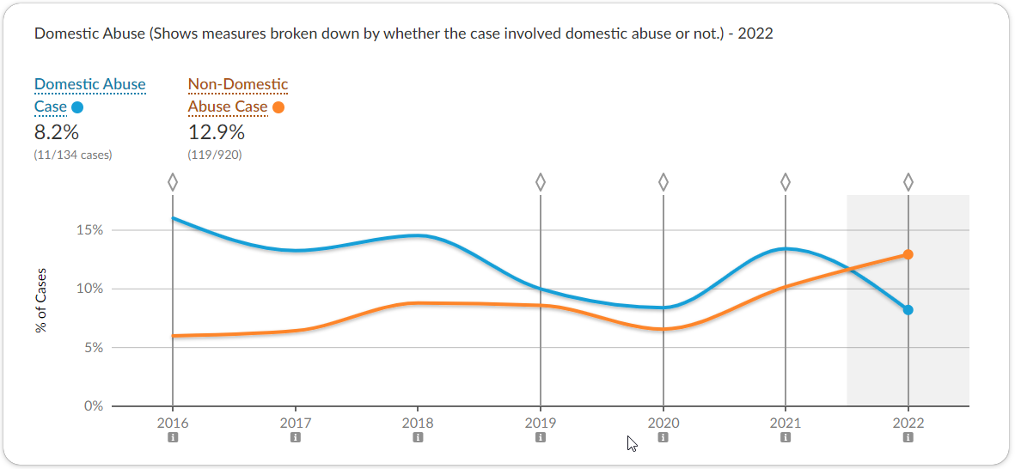
Domestic Abuse Cases Sentenced to State Prison

Slide 6
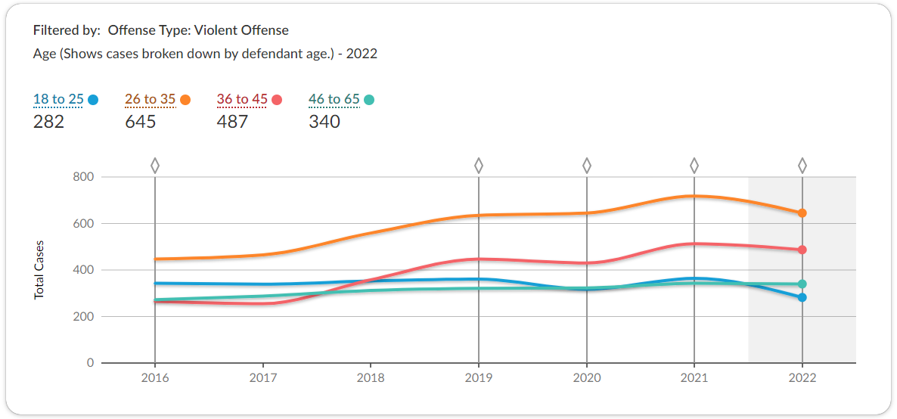
Violent Crimes Referred By Age

Slide 7
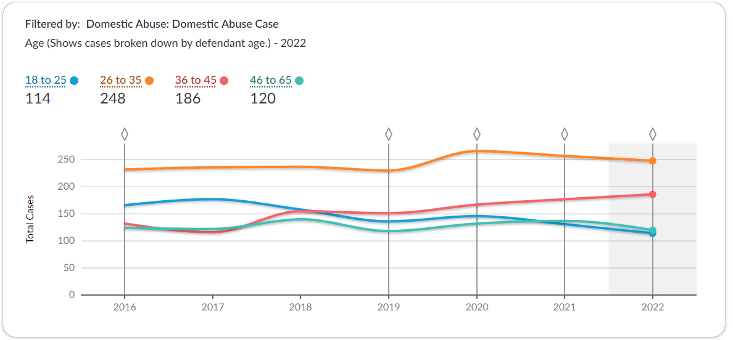
Domestic Abuse Crimes Referred By Age

