Slide 1
Commons Town Hall
Tuesday, January 10th, 2023

Slide 2
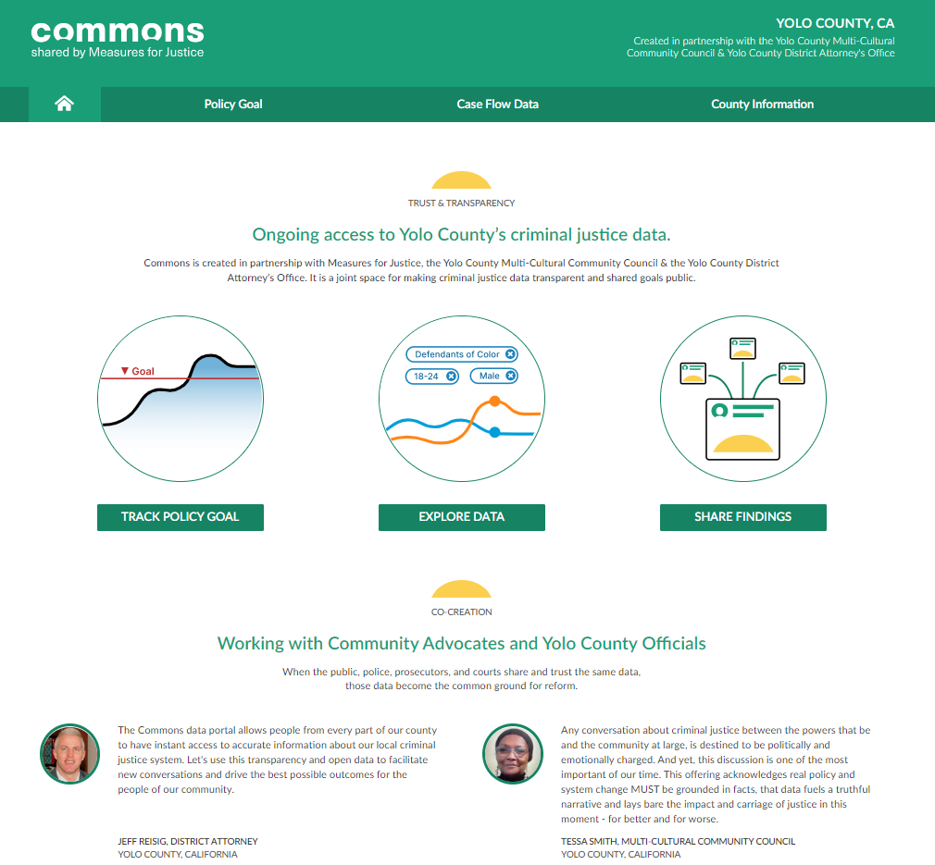
Prosecutor Initiated Resentencing

Slide 3
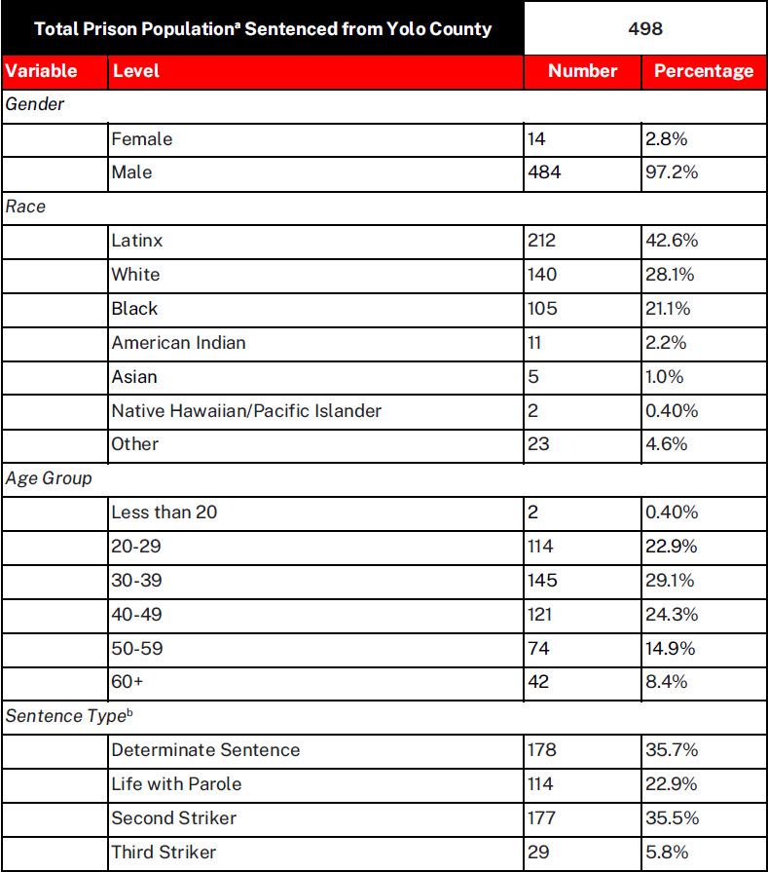
Total Prison Population (Yolo)

Slide 4
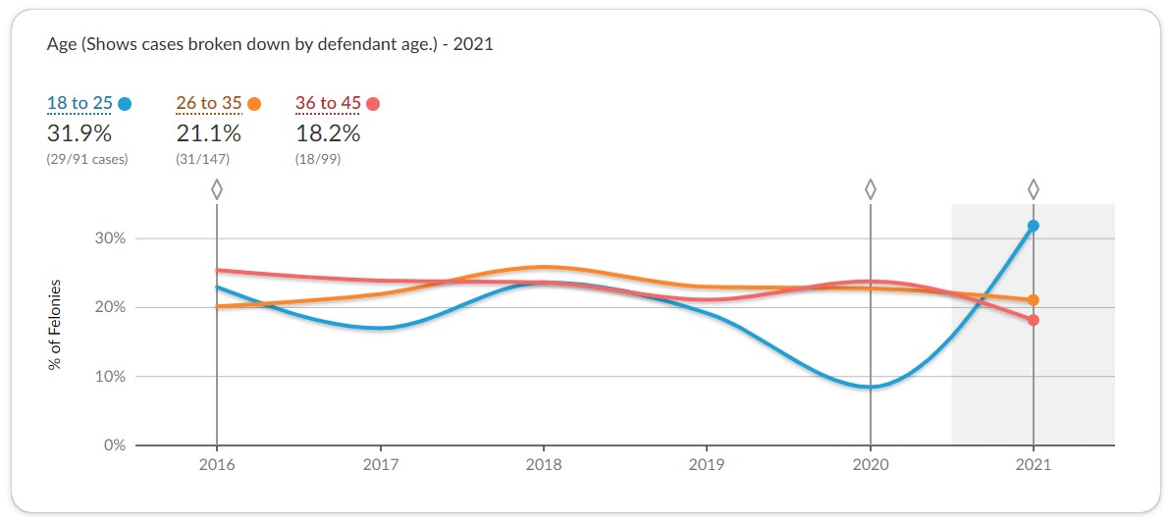
Sentenced to State Prison (Age Ranges)

Slide 5
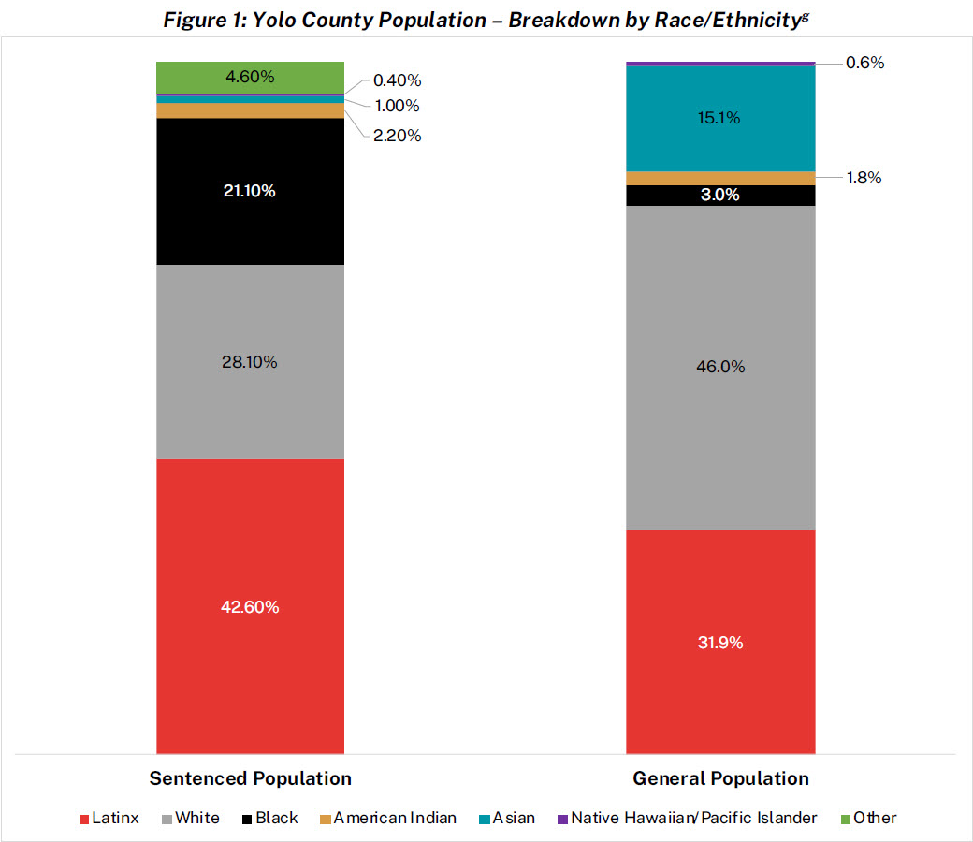
Prison Population – Breakdown by Race

Slide 6
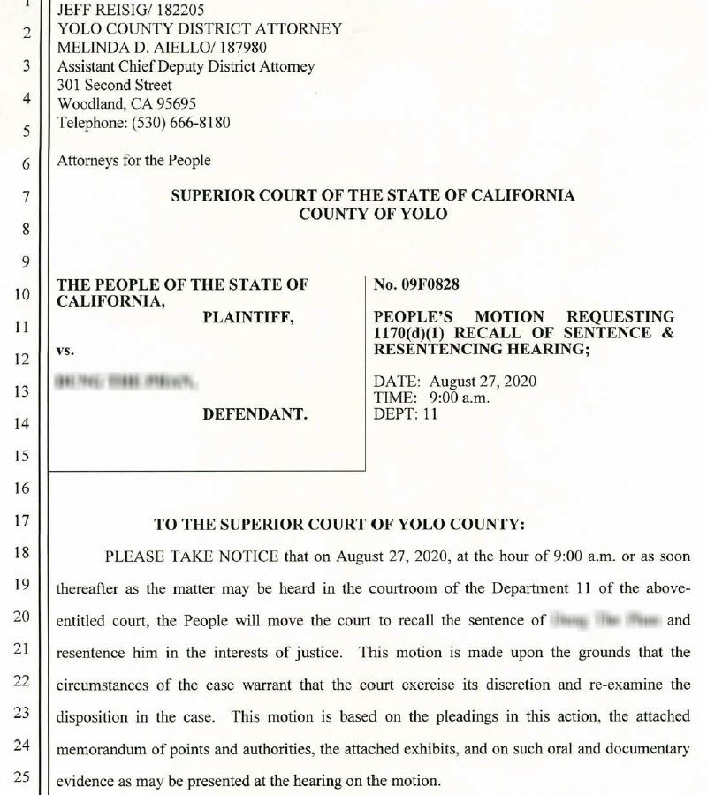
Motion Example

Slide 7
Email to Office
I was thinking of you over Thanksgiving since I have nothing but gratitude for the criminal justice reform that changed Gabriel's and my life. I would still be visiting him in prison. As I told you, he completed parole, is living with his birth family in AZ, and well into his second month of a real job! He sent me a photo of the paperwork accompanying his first pay check. Taxes with held, medicals, hourly rate, overtime. He just got a dollar an hour pay raise to $16.00 and passed the written and driving (!!!) exam to be the junior fork lift driver. He is immensely happy and proud and so am I.
Lindsay

Slide 8
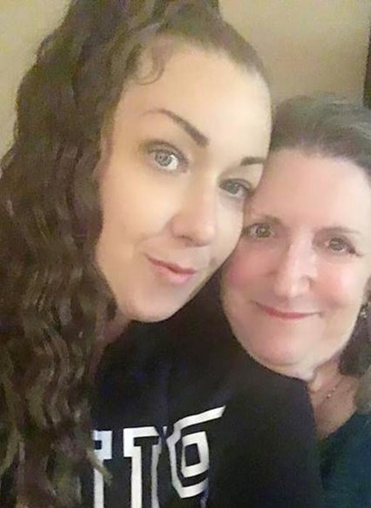
Kaitlin’s Story
Notes:
UCD’s Report Hate and Bias pages and forms includes this definition of HI
Good report form
UCD PD page on Hate Incidents – same definition of HI

