Slide 1
Commons Town Hall
Tuesday, December 13th, 2022

Slide 2
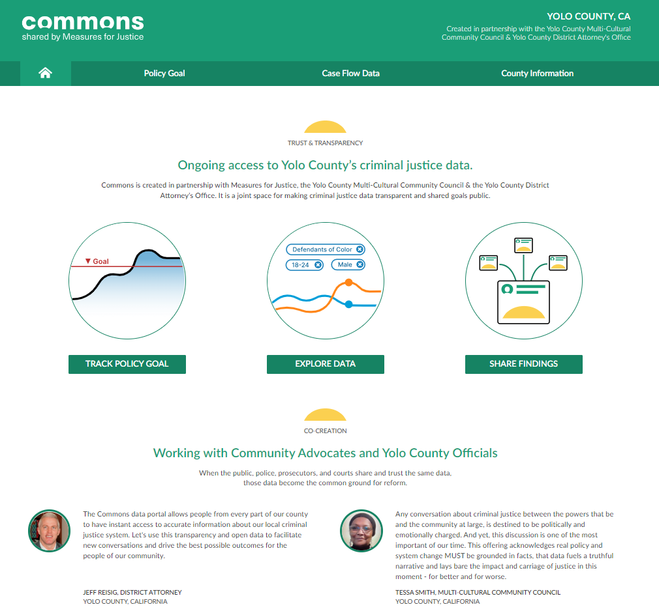

Slide 3
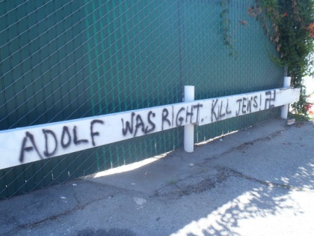
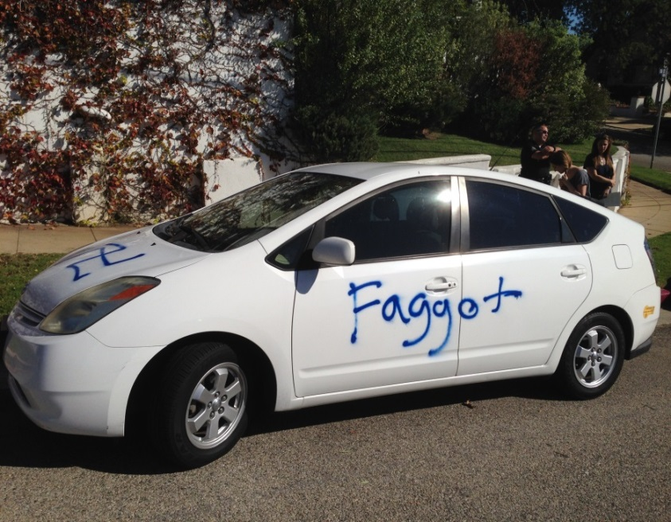
What is a Hate Crime?
HC = Crime + Bias Motivation
Proof: Beyond a reasonable doubt

Slide 4
Hate Crime: CA Penal Code sec. 422.55(a)
A criminal act committed in whole or in part because of one or more of the following actual or perceived characteristics of the victim:
Disability
Gender
Nationality
Race or Ethnicity
Religion
Sexual orientation
Association with a person or group with one or more of these actual or perceived characteristics

Slide 5
Hate Crime
A crime against person or property
In whole/part because of
disability, gender, nationality, race/ethnicity, religion, or sexual orientation

Slide 6
Bias Indicators
Words, gestures, tattoos, jewelry, clothes, graffiti?
Significant day/location for the victim’s group?
History of tension between groups?
Differences between the suspect and victim?
Suspect involved in similar incidents?
Victim new to the community?
Suspect went to victim’s area? Vice versa?
Excessive or symbolic violence?
Opinions of victim/community/suspect?
No other rational reason for the crime?

Slide 7
Hate Incident
Non-criminal conduct which is motivated by hatred, prejudice or bigotry and directed at any individual, residence, or house of worship, institution or business expressly because of the victim’s (person or institution) real or perceived race, nationality, ethnicity, religion, sexual orientation, gender, or disability.
Notes:
UCD’s Report Hate and Bias pages and forms includes this definition of HI
Good report form
UCD PD page on Hate Incidents – same definition of HI

Slide 8
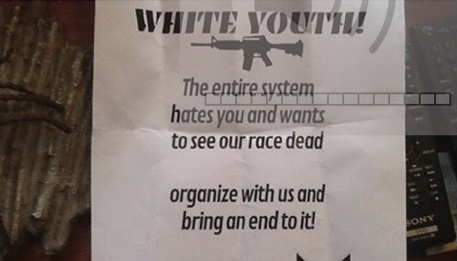
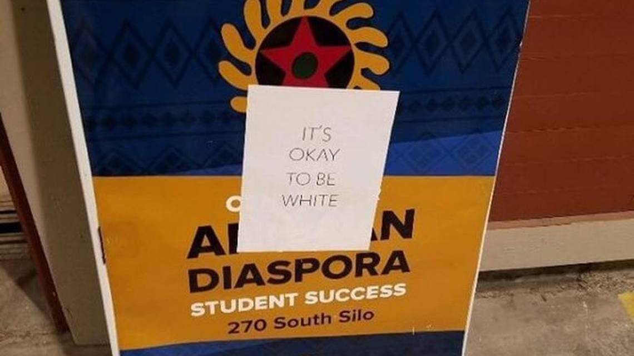
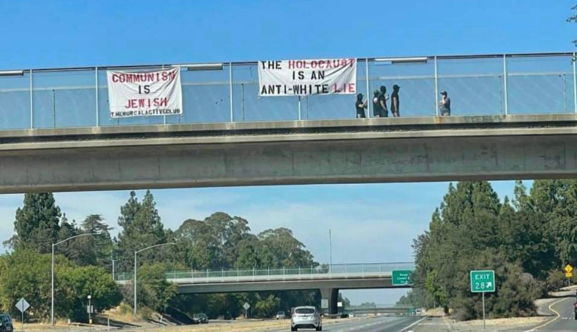
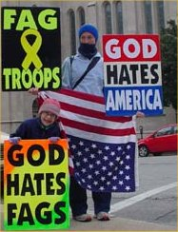
Notes:
https://www.sacbee.com/news/local/education/article183983876.html – UC Davis 11/2017
https://commons.wikimedia.org/wiki/File:WBC_protest.jpg – WBC Tulsa, OK, 2005
https://www.dailydemocrat.com/2019/07/11/white-nationalist-fliers-found-around-eureka-police-notify-fbi-and-terrorism-liaison/ - Eureka, Iron Youth, 7/2019
https://jweekly.com/2022/08/30/antisemitic-banners-hung-near-uc-davis-by-white-supremacist-fight-club/

Slide 9
Hate Crime Targeting Statistics

Slide 10
Notes:
https://www.sacbee.com/news/local/education/article183983876.html – UC Davis 11/2017
https://commons.wikimedia.org/wiki/File:WBC_protest.jpg – WBC Tulsa, OK, 2005
https://www.dailydemocrat.com/2019/07/11/white-nationalist-fliers-found-around-eureka-police-notify-fbi-and-terrorism-liaison/ - Eureka, Iron Youth, 7/2019
https://jweekly.com/2022/08/30/antisemitic-banners-hung-near-uc-davis-by-white-supremacist-fight-club/

Slide 11
Hate Crime Referrals

