Slide 1
Commons Town Hall
Tuesday, November 8th, 2022

Slide 2
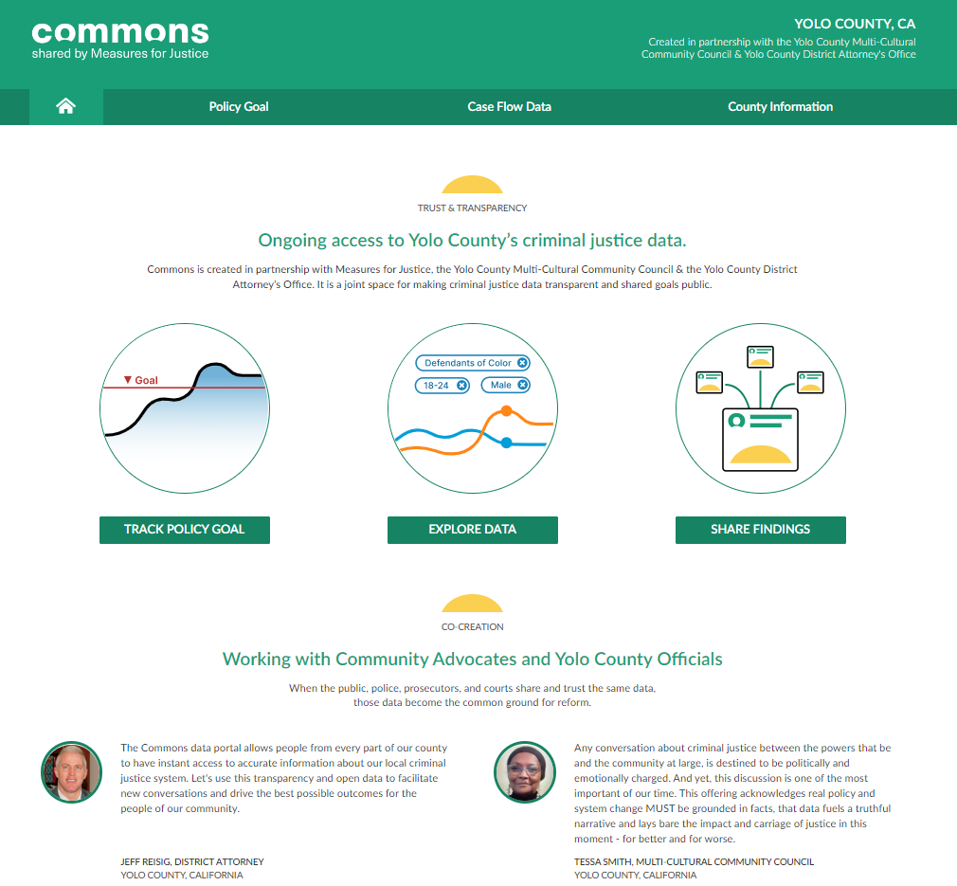

Slide 3
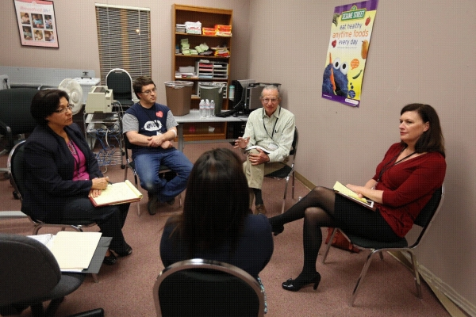
Restorative Justice Partnership (RJP)

Slide 4
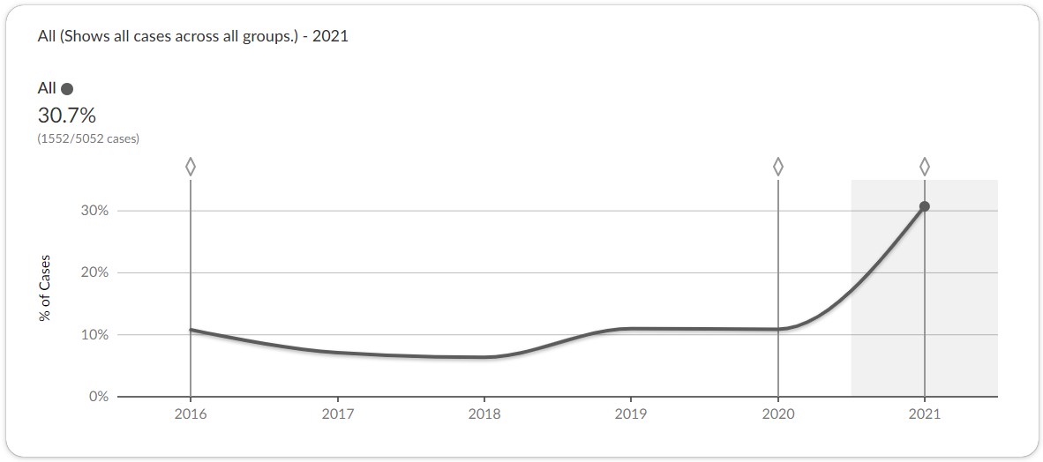
Cases Diverted by the Yolo DA’s Office

Slide 5
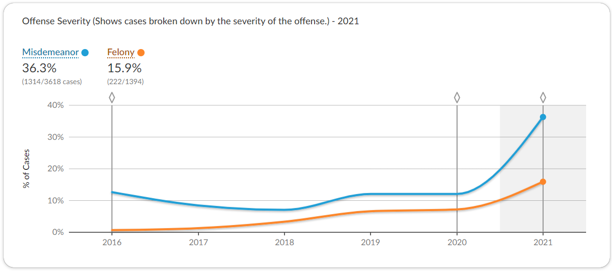
Cases Diverted by Felony & Misdemeanor

Slide 6
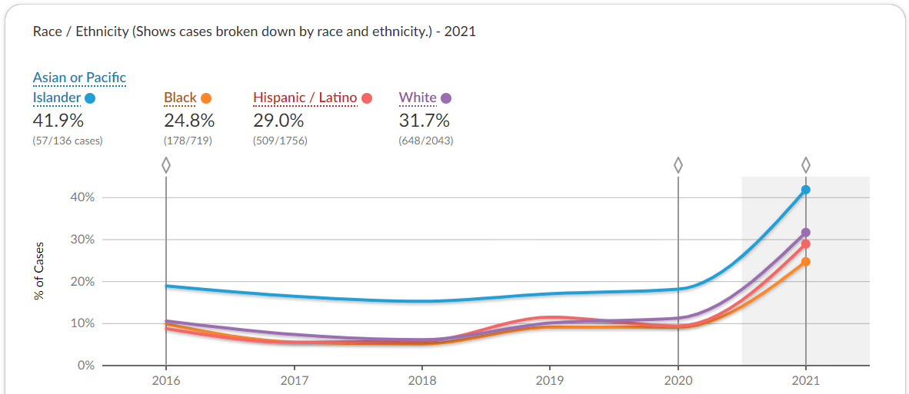
Cases Diverted by Race

Slide 7
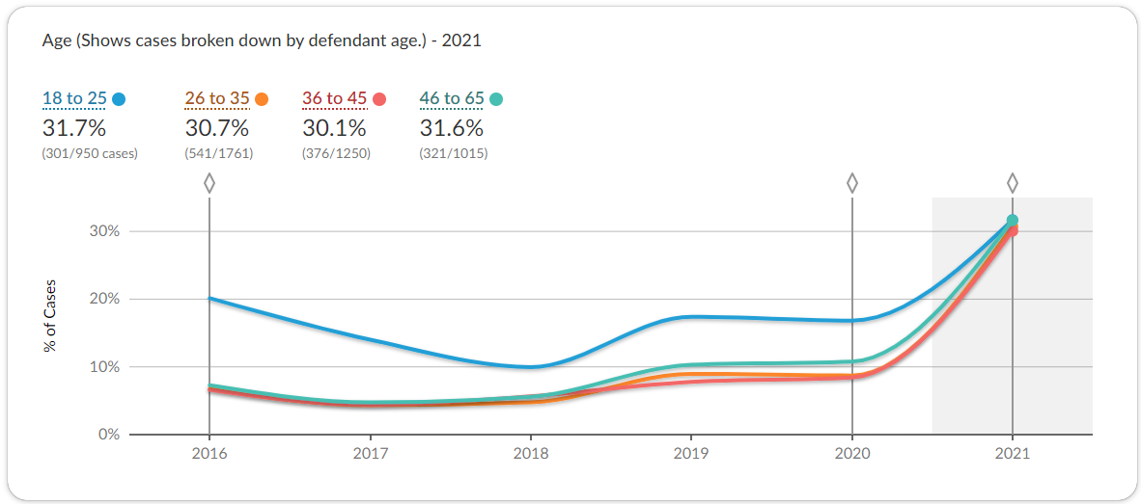
Cases Diverted by Age

