Slide 1
Commons Town Hall
Tuesday, August 9th, 2022

Slide 2
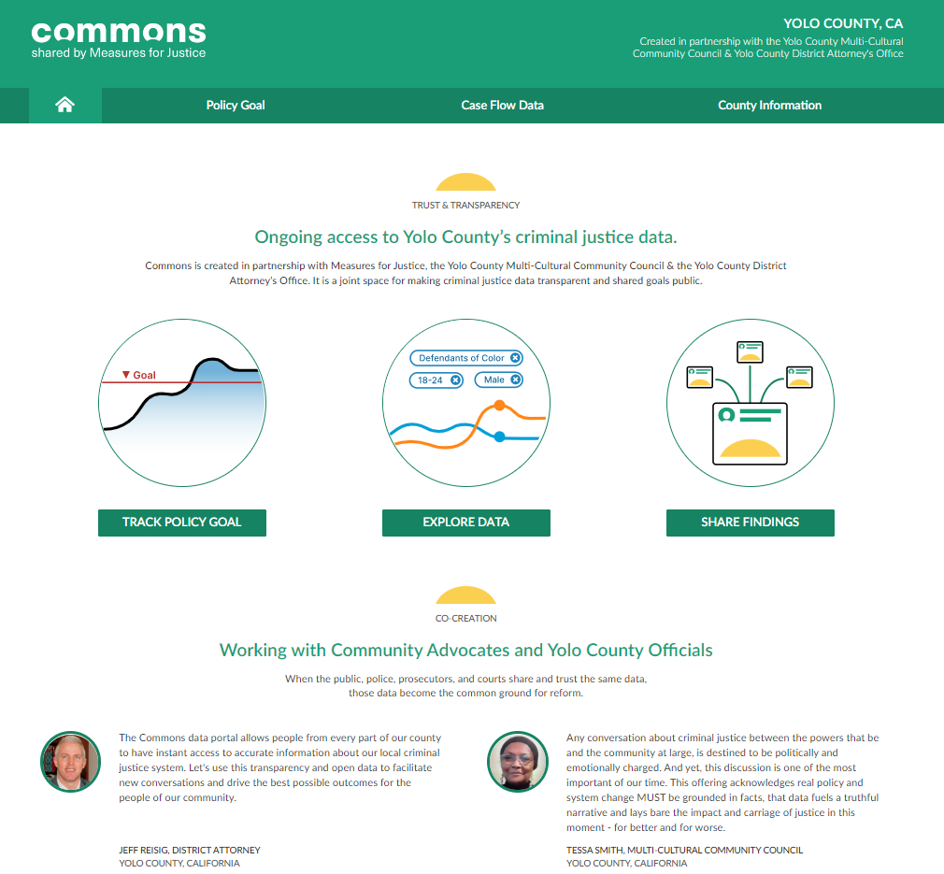

Slide 3
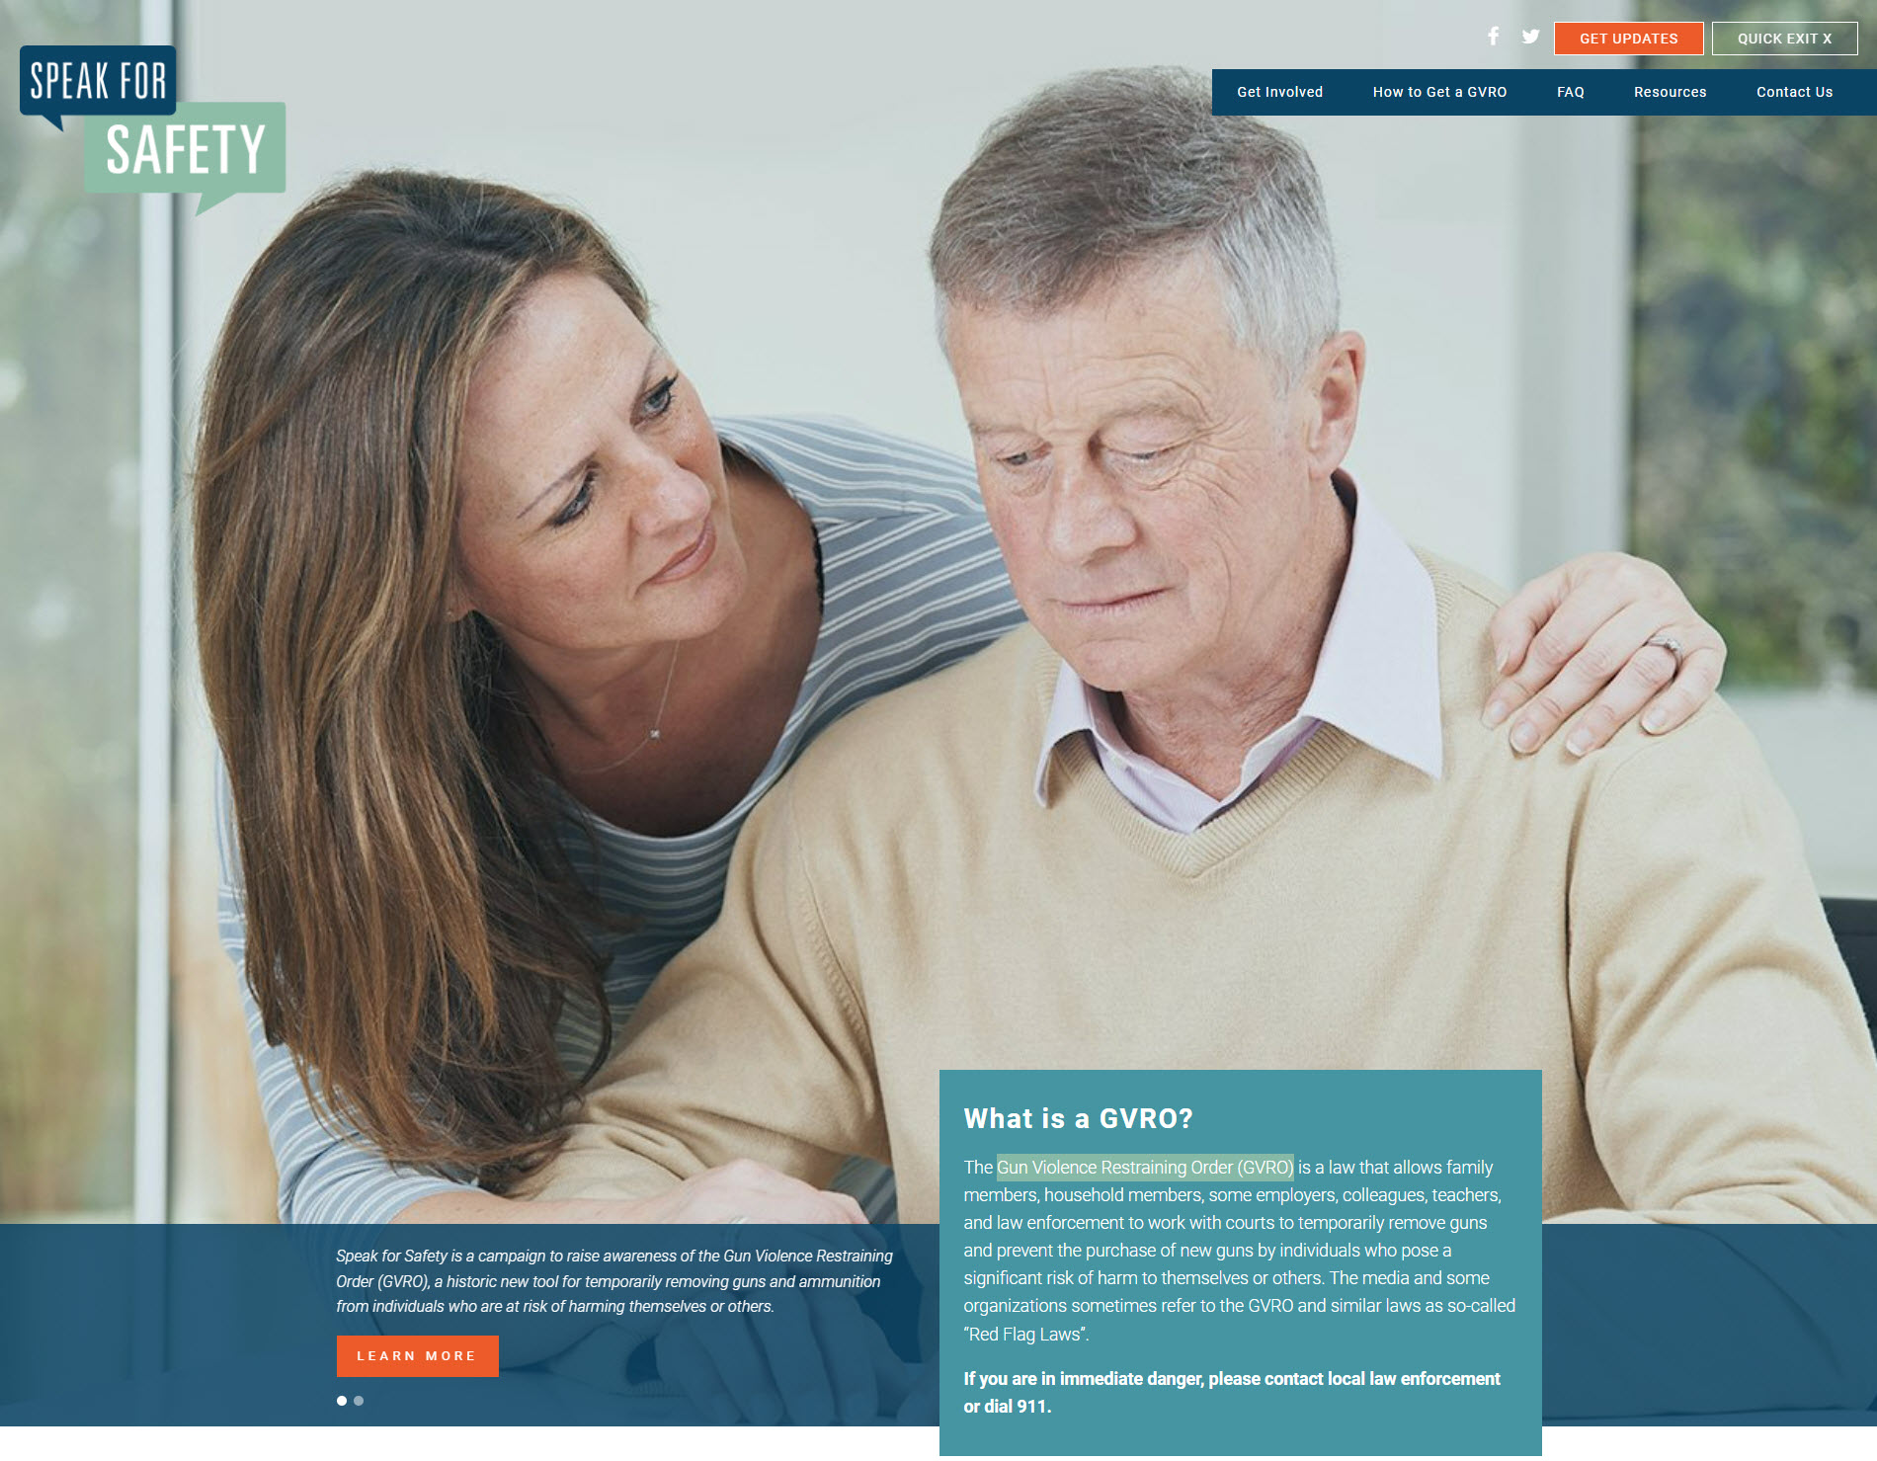
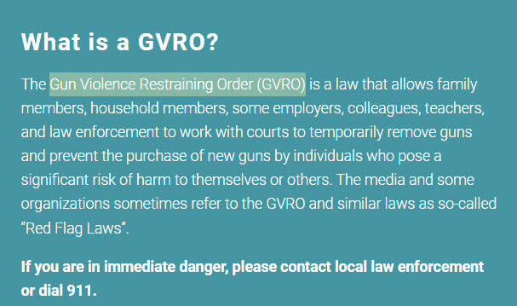
Gun Violence Restraining Order (GVRO)
Website: https://speakforsafety.org/
GVRO Forms: GV-110, GV-109, CLETS-001, and GV-100

Slide 4
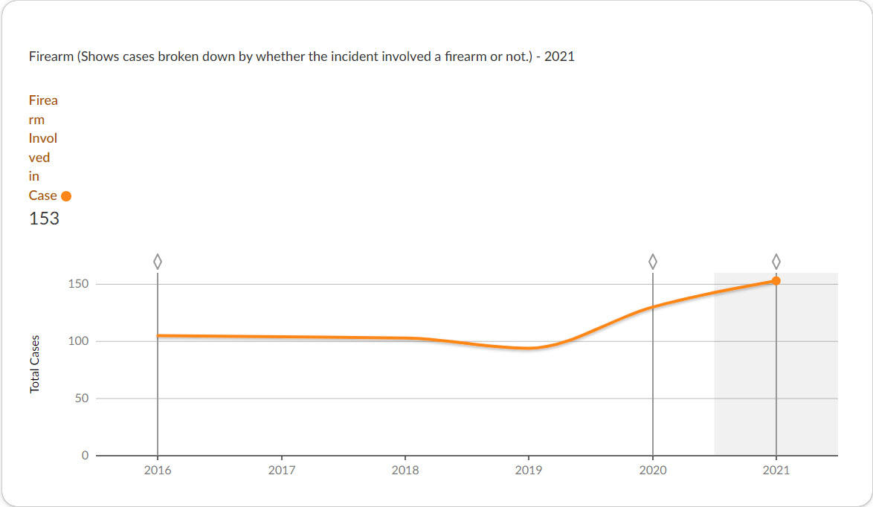
Cases Referred to the Prosecutor Involving Firearms

Slide 5
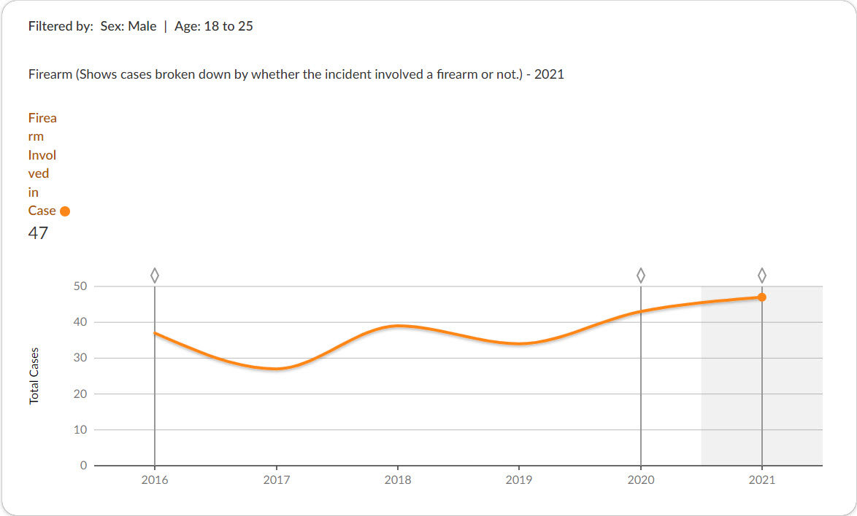
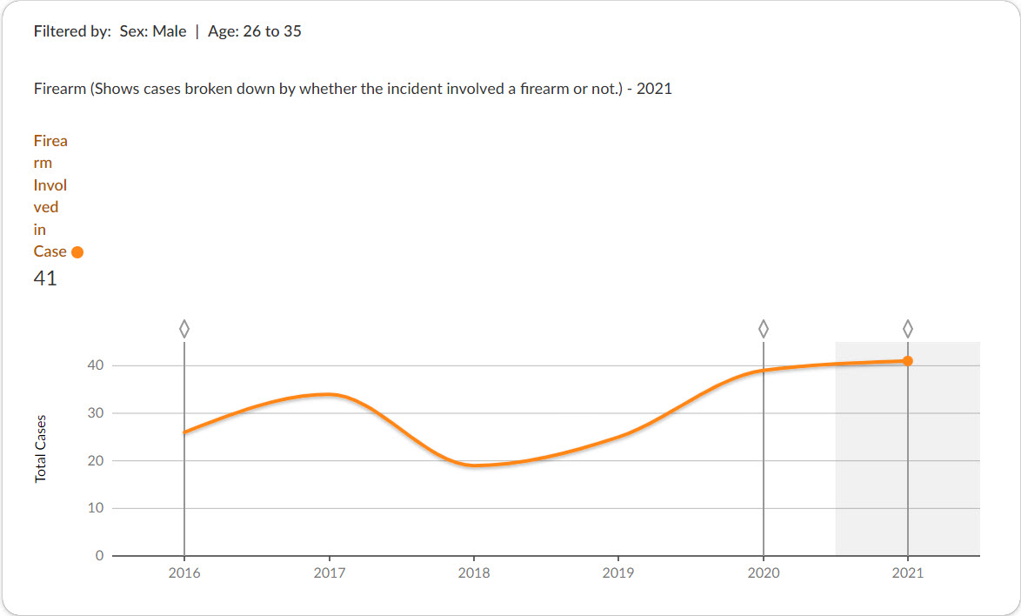
Cases Referred to the Prosecutor Involving Firearms (Males Ages 18-25 and 26-35)

