Slide 1
Commons Town Hall
Tuesday, July 12th, 2022

Slide 2
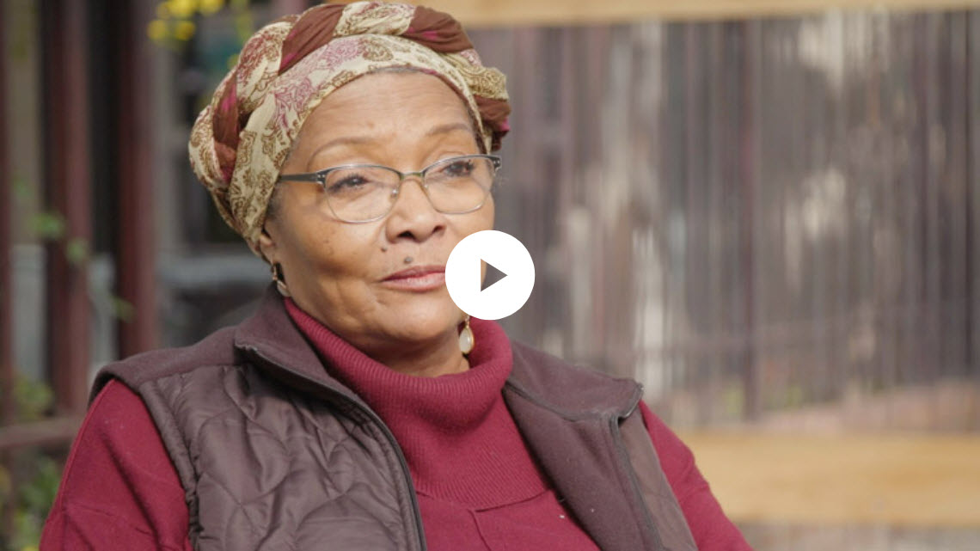
Measures for Justice - Yolo Commons

Slide 3
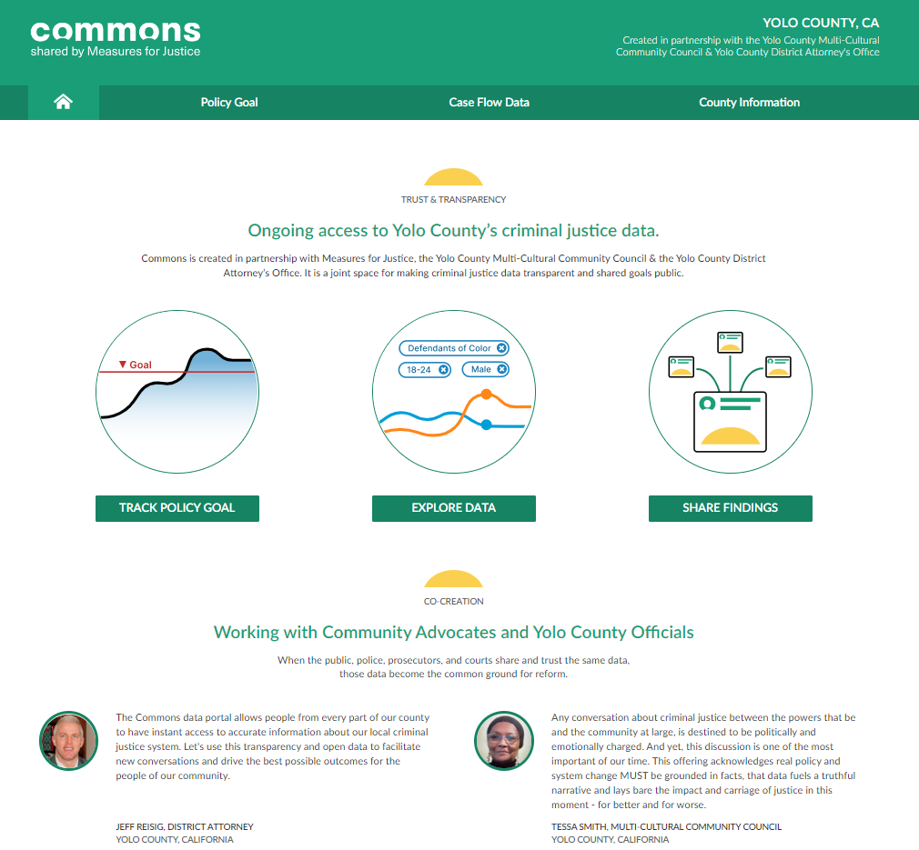

Slide 4
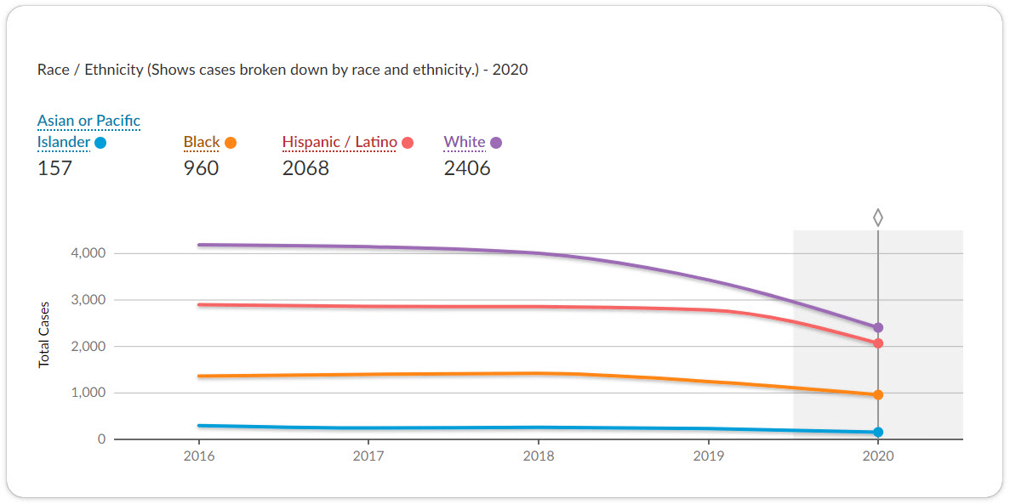
Cases Referred to the Prosecutor

Slide 5
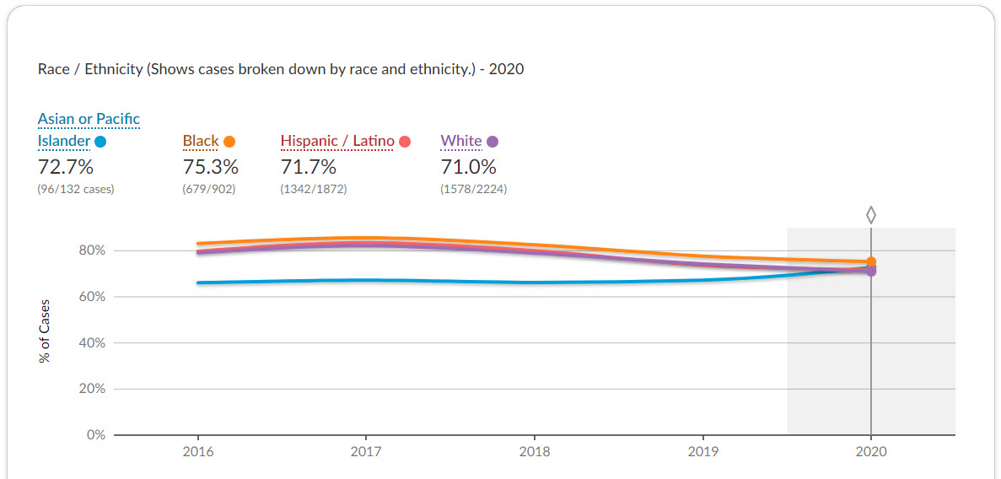
Cases Prosecuted

Slide 6
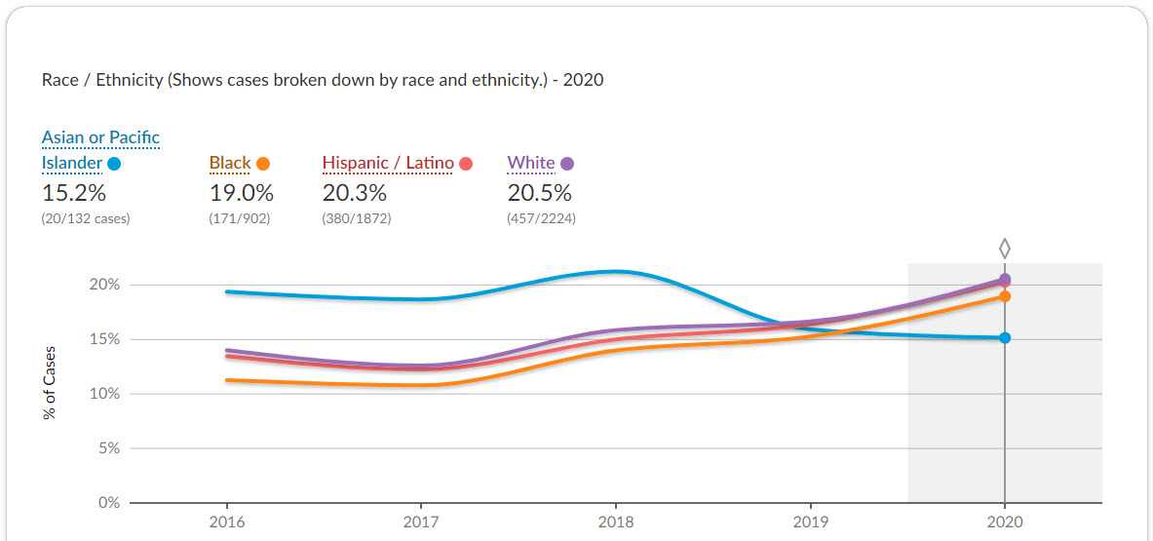
Cases Rejected for Prosecution

Slide 7
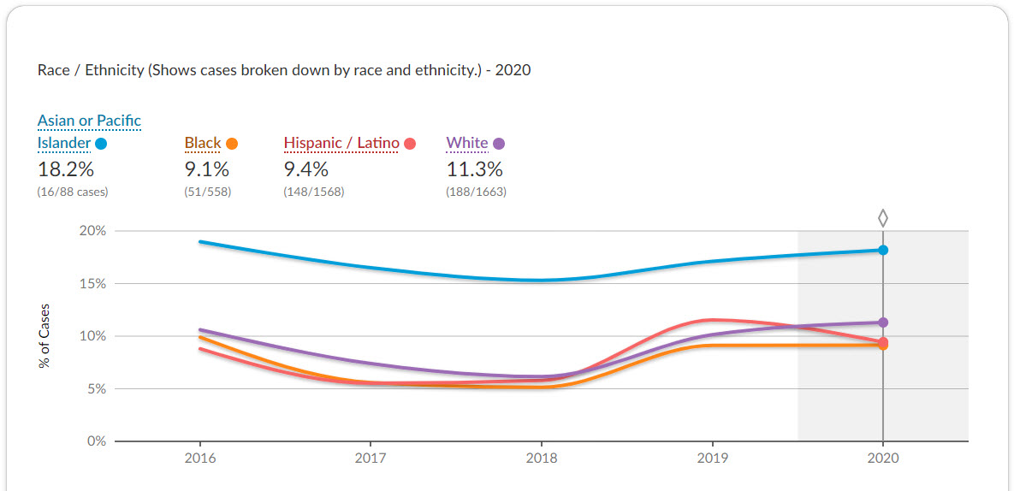
Cases Diverted

Slide 8
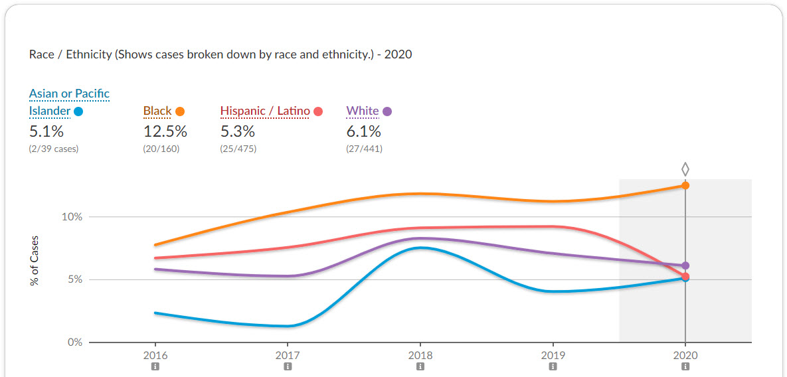
Cases Sentenced to State Prison

